Slide 1
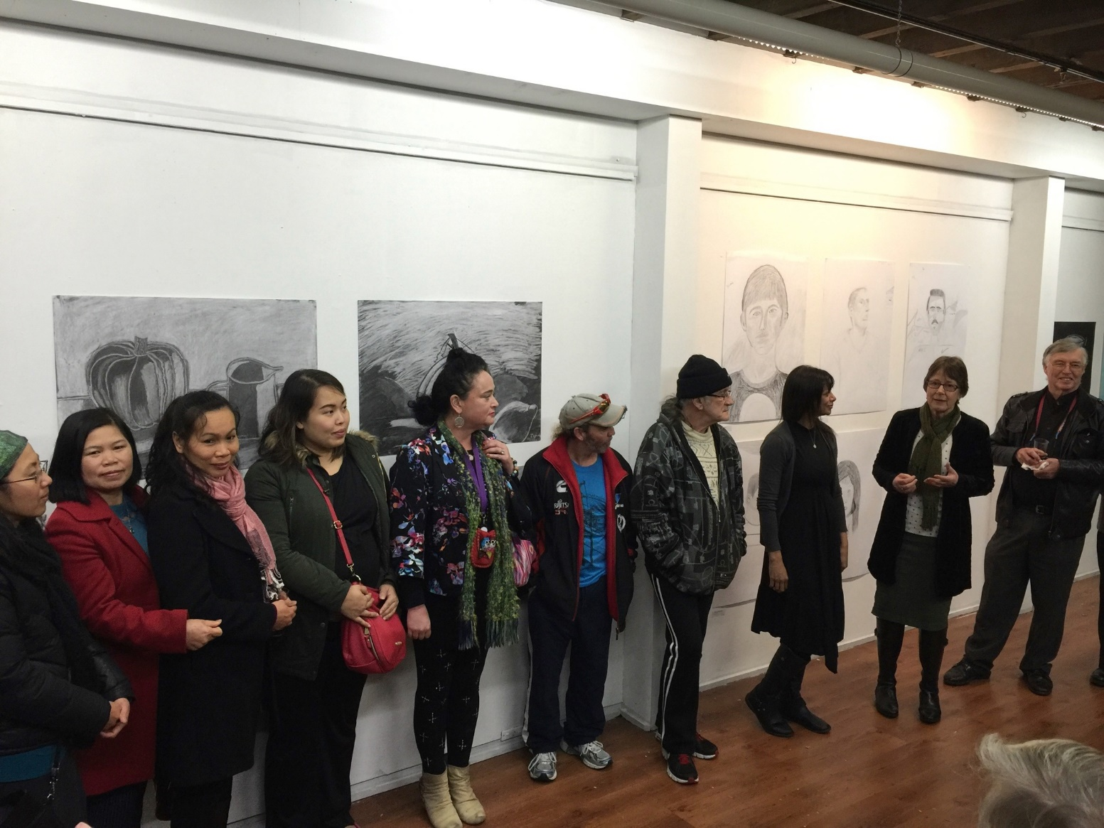
UTAS Teaching for Togetherness: Utilising Student and Community Partnerships to Deliver the Clemente Program

Slide 2
The Clemente Program
Clemente Australia, an innovative university-level program for Australians experiencing multiple disadvantage and social isolation, is founded on Earl Shorris's (2000) Clemente program in the USA.
An example of Community-Embedded, Socially-Supported (CESS) university education model

Slide 3
Clemente Tasmania: UTAS, ACU, Hobart Catholic Archdiocese, Anglicare, Common Ground, Edmond Rice Centre, Catholic Care, St Vincent de Paul, The Smith Family, LINC Centres

Slide 4
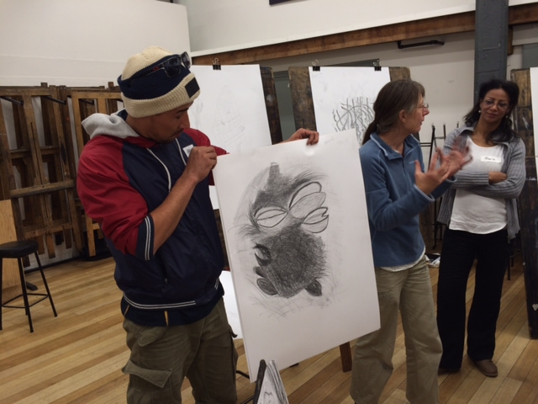
Clemente’s Goals
Using liberal arts education to enhance self-confidence, social engagement
Make university education accessible to disadvantaged Australians
→ agency thinking
→ pathway thinking
Notes:
May require more than one slide

Slide 5
CESS Model
Delivery in an environment with which students are familiar/comfortable;
Small classes (generally 8-15);
Humanities education;
Rigorous university level education;
Lecturers with flexible and engaging methods of teaching and communicating;
Learning partners who supports students’ non-educational needs;
Administration and technical support.
(Mission Australia, 2007).
Notes:
May require more than one slide

Slide 6
Collaborative Partnerships
Clemente Model
Australian Catholic University
Faculty of Arts
Dean Heads of Schools Academics Professional staff
4 Foundation levels units
Community Organisations
Anglicare Common Ground
Edmond Rice Centre
Financial and in kind Support
Clemente Tasmania Committee
Catholic Care
St Vincent de Paul
The Smith Family
LINC Centres
Hobart Rotary
Salamanca Rotary
Hobart City Council
Archdiocese of Hobart
ACU
Guildford Young College Hobart
University of Tas
(RIGS Grant)
Students
Those who have been denied an education or have been disconnected from education
A core group of 24 students who have participated at various times.
10 students have completed all 4 units.
Mentors
Volunteers who have given up their time to work with the students.
Many mentors are retired or practicing teachers

Slide 7
Clemente Units Four units - One 2 hour workshop over 12 weeks per unit -Students also spend time with a learning mentor
Unit 1: Indigenous Studies
Unit 2: Sociology
Unit 3: Drawing
Unit 4: Philosophy
Semester 2 2015
Summer 2016
Semester 1 2016
Semester 2 2016

Slide 8
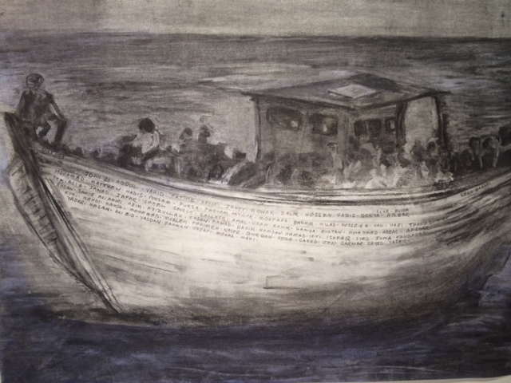
Introduction to Indigenous Australia: Past and the Present
Adapting material that would suit a foundation level unit – challenges.

Slide 9
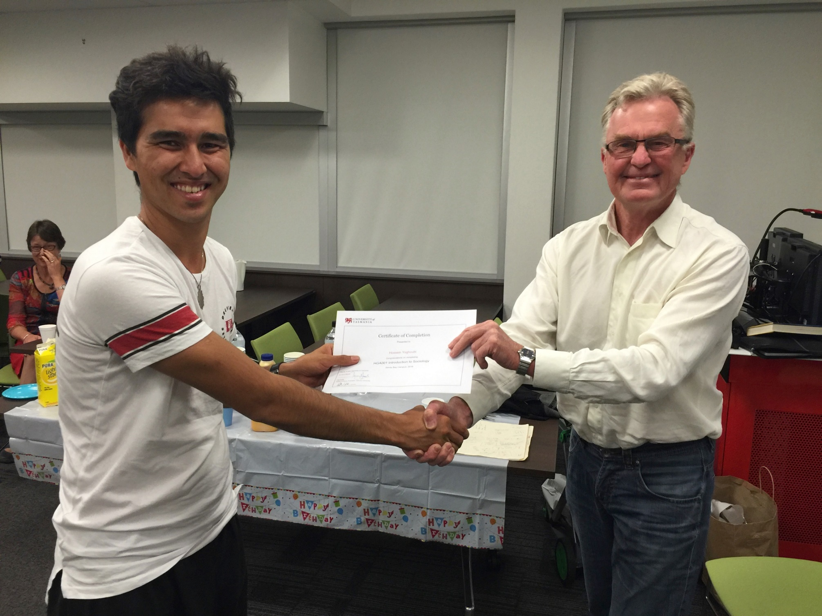
Introduction to Indigenous Australia: Past and the Present
Choosing the right teacher who has the teaching and disciplinary expertise, together with an understanding of a student cohort with different educational needs.
Notes:
May require more than one slide

Slide 10
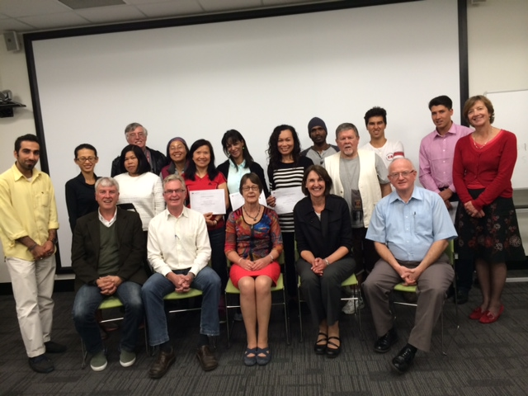
Introduction to Indigenous Australia: Past and the Present
Taking a flexible approach to teaching delivery and assessment, in order to adapt to the needs and learning styles of the group.

Slide 11
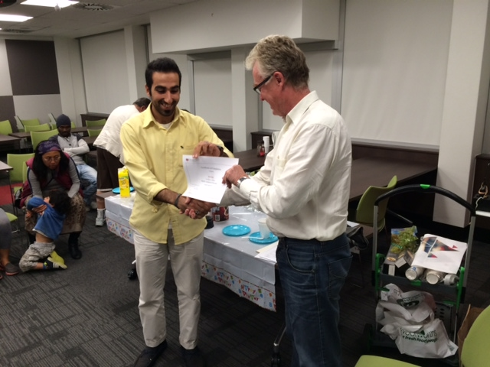
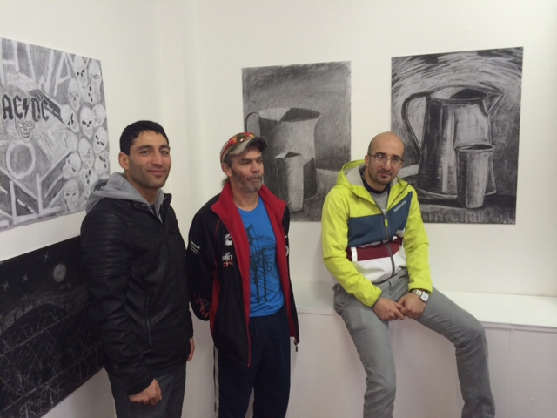
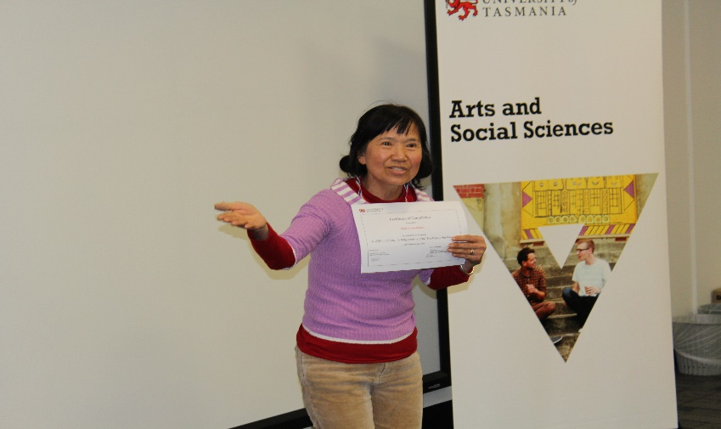
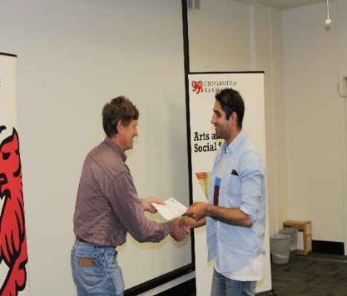
Questions?
Notes:
May require more than one slide

