Slide 1
Practice and Portfolios:
Embedding WIL in Associate Degrees
Teaching Matters
7 December 2016
Hawkins, C.J., Symes, M., Burbury, M., Allison, J., Collins, R., Broun, D., Hawkins, C., & Ives, S.

Slide 2
This Presentation
What are the new associate degrees?
WIL Types
Proximity and Authenticity
Structure of the ADegAppBus
Integration Model (a work in progress)
Reflective ePortfolios

Slide 3
WIL Types

Slide 5
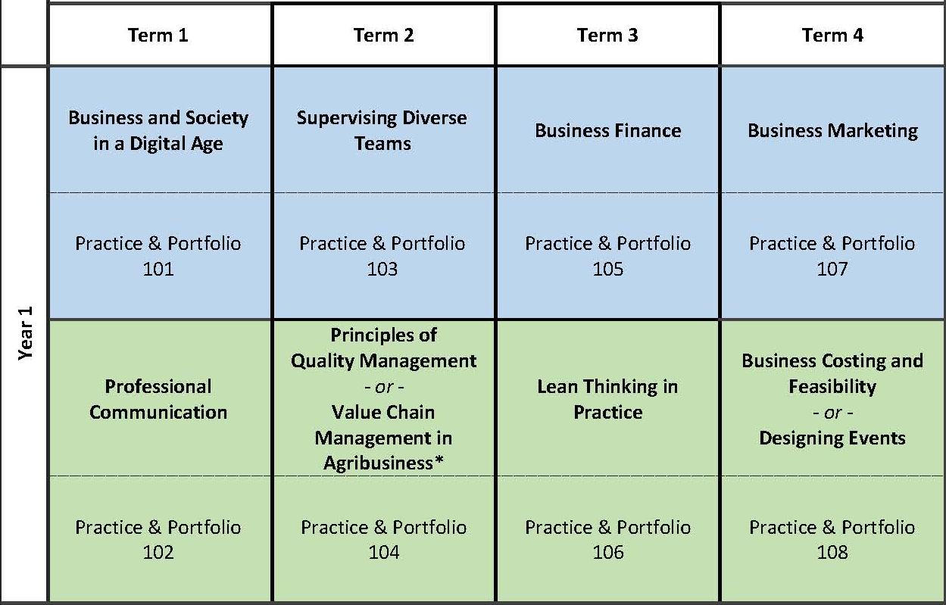
First Year Example: General Business

Slide 6
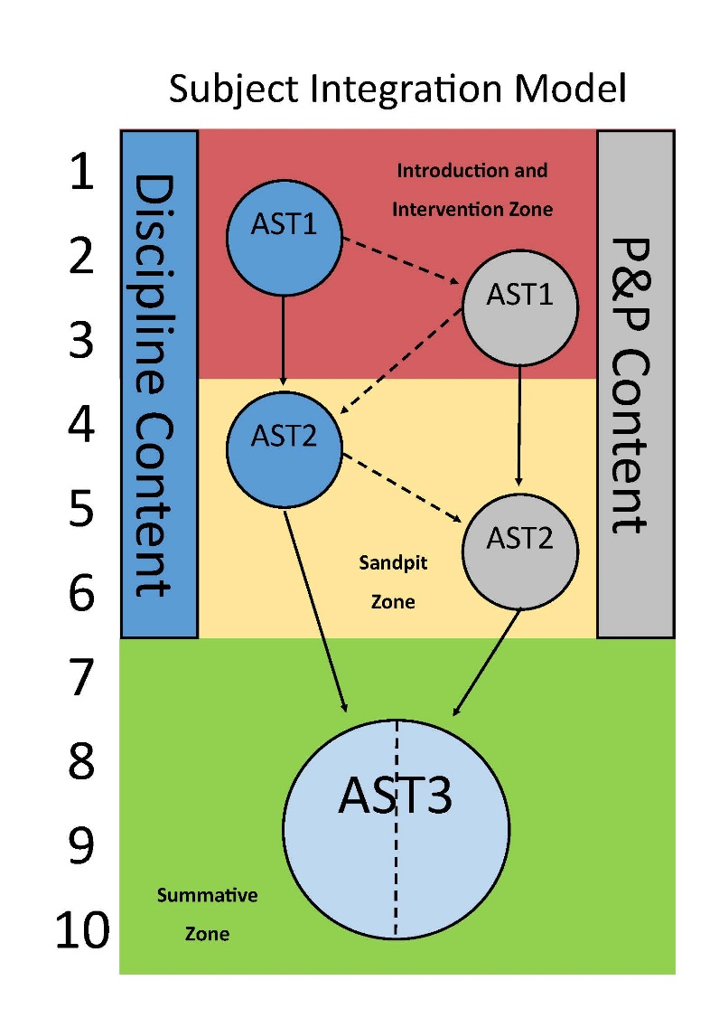

Slide 7
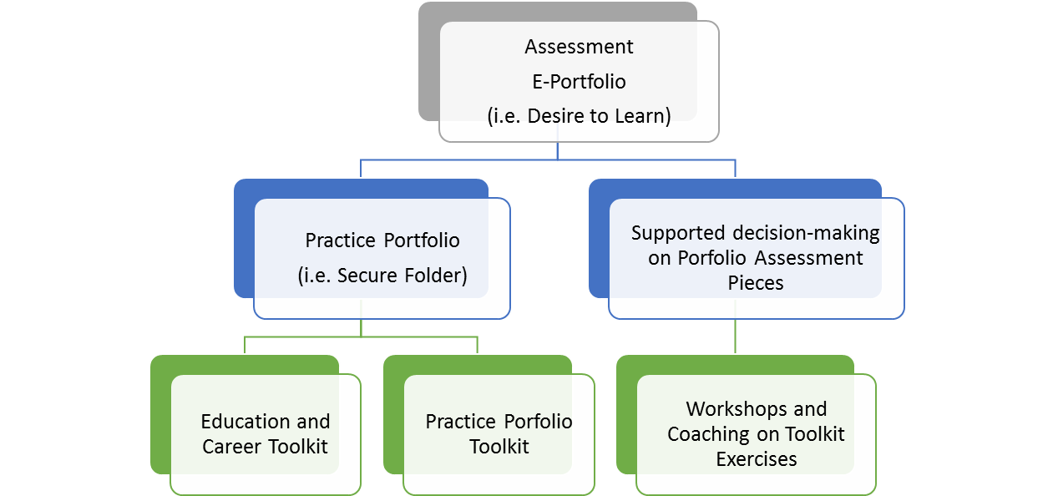
Practice & Portfolio Process

Slide 8
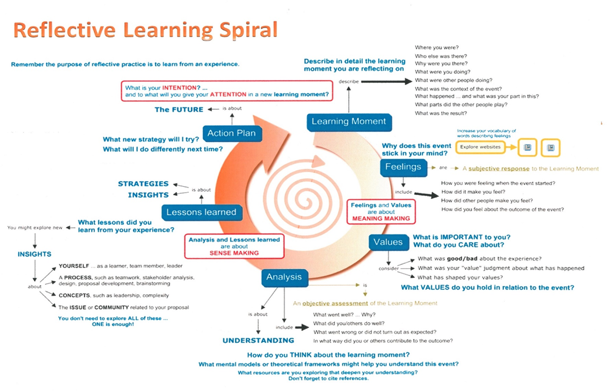
Prpic (2016): http://skat.ihmc.us/rid=1PC8NRGW0-2BL1DL-2GNL/ReflectiveLearningSpiral-JKayaPRPIC.cmap

