Slide 1
Helping Hands
Transforming practice through innovation in supervision
Carey Mather
Tony Barnett
Tony Huang
Vlasti Broucek
Annette Saunders

Slide 2
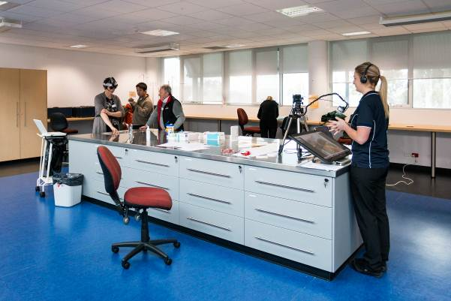
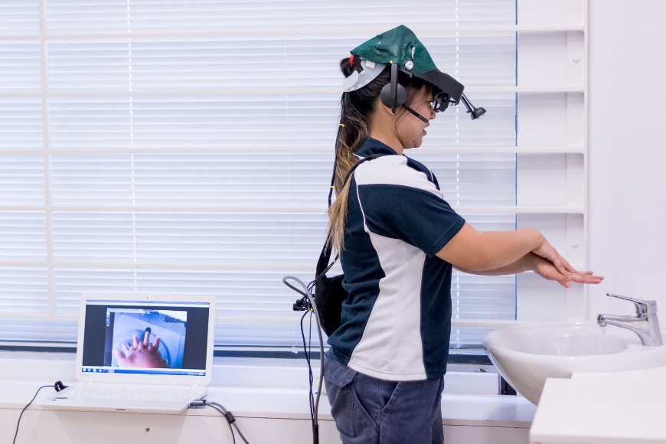
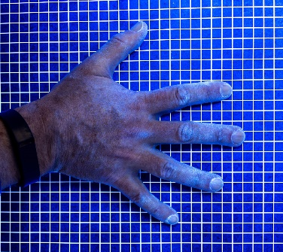
Helping Hands

Slide 3
7 STEPS TO EFFECTIVE
HAND WASHING
1. Palm to palm
2. Right palm over left dorsum and left palm over right dorsum
3. Palm to palm
4. Backs of fingers to opposing palms with fingers interlocked
fingers interlaced
7.
5. Rotational rubbing of
right thumb clasped in left palm and vice versa
6. Rotational rubbing,
7. Rotational rubbing of left wrist
backwards and forwards with clasped fingers of right hand in left palm and vice versa
in with right palm and vice versa

Slide 4
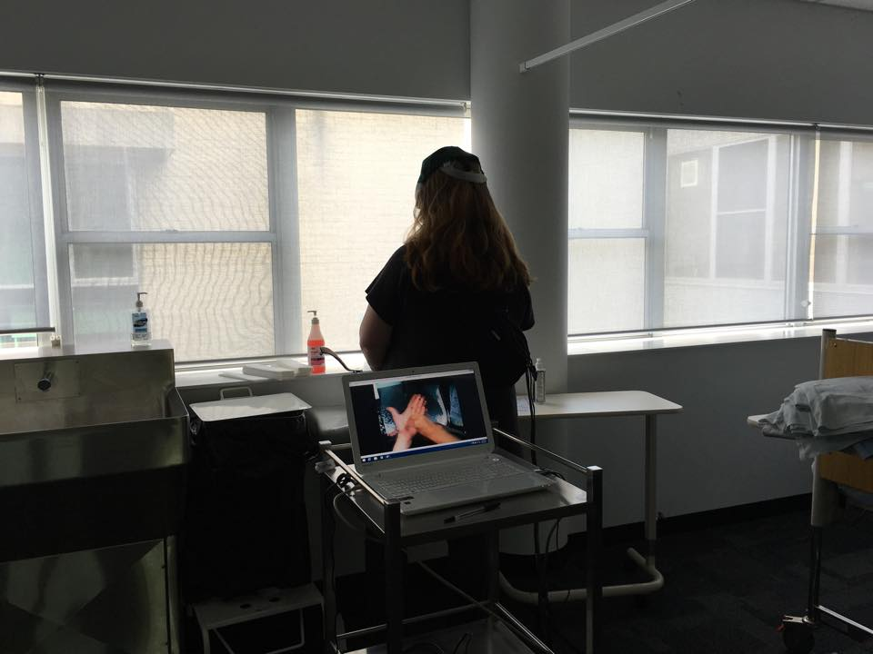
Background

Slide 5
Reference group
Anthony Carnicelli (Paramedic Educator and ICU Paramedic, Ambulance Tasmania)
Dr Winyu Chinthammit (Lecturer, Computing & Information Systems, University of Tasmania (UTAS))
Dr Merylin Cross (Senior Lecturer, Centre for Rural Health (CRH), UTAS)
Deirdre Douglas (Clinical Educator, Launceston General Hospital)
Robyn Johnstone (Nurse Educator, Tasmanian Health Organisation, Ulverstone)
Dr Ioan Jones (Oral Health Services Tasmania, Senior Clinical Lecturer, CRH)
Mark Kirschbaum (Lecturer in Rural Pharmacy, CRH)
Tia McCarthy (Student representative, UTAS)
Annette Saunders (Lecturer, School of Health Science, UTAS)

Slide 6
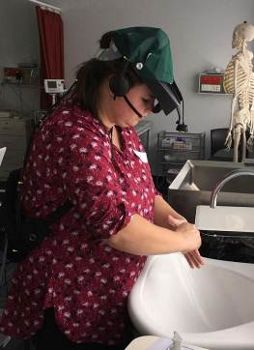
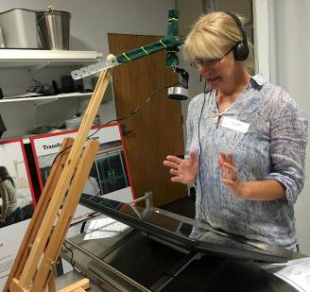
Feasibility trial
Near-eye display
Headphones and microphone
Headphones
Camera
Camera
Microphone
Display screen

Slide 7
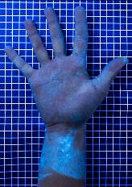
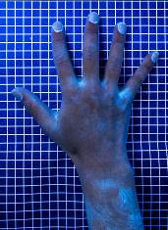
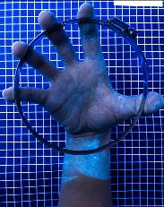
Objective measurement using GlitterbugTM

Slide 8
Usability trial

Slide 9
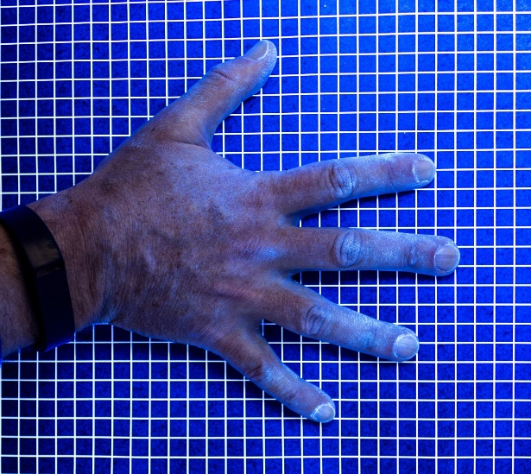
No difference in educational outcomes

Slide 10
End user acceptance Ratings of the Helping Hands system by participants. (Scale: 1 =strongly disagree to 5 = strongly agree with statement)
Experimental (Helping Hands) Group (n=9) | Mean (sd)
I found that the system was easy to learn | 4.3 (1.3)
I found that the system was easy to use | 4.1 (1.3)
I found that the system was useful way to receive guidance | 4.3 (1.3)
I was satisfied with my own task performance | 4.2 (0.8)
I was satisfied with the interaction between myself and the instructor | 4.4 (1.3)
I felt that I was engaged with the instructor during the procedure | 4.4 (1.3)
I found the visual instruction easy to follow | 4.4 (1.3)
I found the verbal instruction easy to follow | 4.6 (1.3)

Slide 11
Human interaction and Helping Hands
Advantages
Learner Increase confidence Reduce fear Enable visualisation Promote reflection Increase understanding Enable critique One-on-one instruction Reinforce skills Refine skills Check and provide feedback in real-time | Context Enable second opinion or follow-up Enable immediate feedback as used in real-time Enable assessment of procedure Enable assessment of patients Examine learner technique Useful for novice Provide support/backup Clarify gaps or misconceptions Promote safe practice Efficient use of resources Provides teaching and learning partnership Patient can feel ‘special’
Disadvantages
Learner Increase anxiety, could be frightening, particularly for children or dementia patients Identifies the learner Lack of presence Task orientated Opportunity for disconnect between learner and patient | Context Complicated to set up Requires training Requires Information Technology (IT) competence to troubleshoot Technology dependence, risk with IT failure Looks intimidating Time consuming

Slide 12
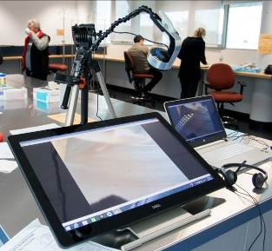
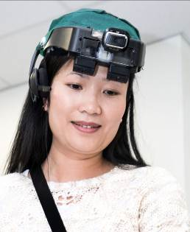
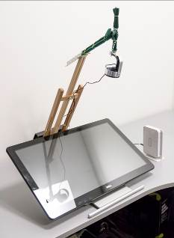
Helping Hands

Slide 13
Questions?
Carey Mather Lecturer, School of Health Sciences
Tony Barnett Centre for Rural Health
Weidong Huang School of Engineering and ICT, Faculty of Science, Engineering and Technology
Vlasti Broucek Adjunct Researcher, Tasmanian Institute of Law Enforcement Studies
Annette Saunders Lecturer, School of Health Sciences

