Slide 1
Walking Together
Enhancing staff and student leadership and mentorship capability at Rozelle
Academic Staff: Dr Marguerite Bramble, Dr Hazel Maxwell, Graham Munro, Richard Say, Dr Grace Stankiewicz, Rochelle Einboden, Dr Chin-Liang Ben, Sally Farrington, Prof Greg Rickard (Chief Investigator)
Student Mentors: Jordy Aldridge, Jaya Warby-Sullivan, Jessica Arnold, Rasoul Alhassani, Duncan Kaehne, Jessica Tomassini, Katie Nguyen, Zoe Puechberty, Mirwais Adli
Research Assistant: Esther Marembo

Slide 2
Leadership and Mentoring at Rozelle

Slide 3
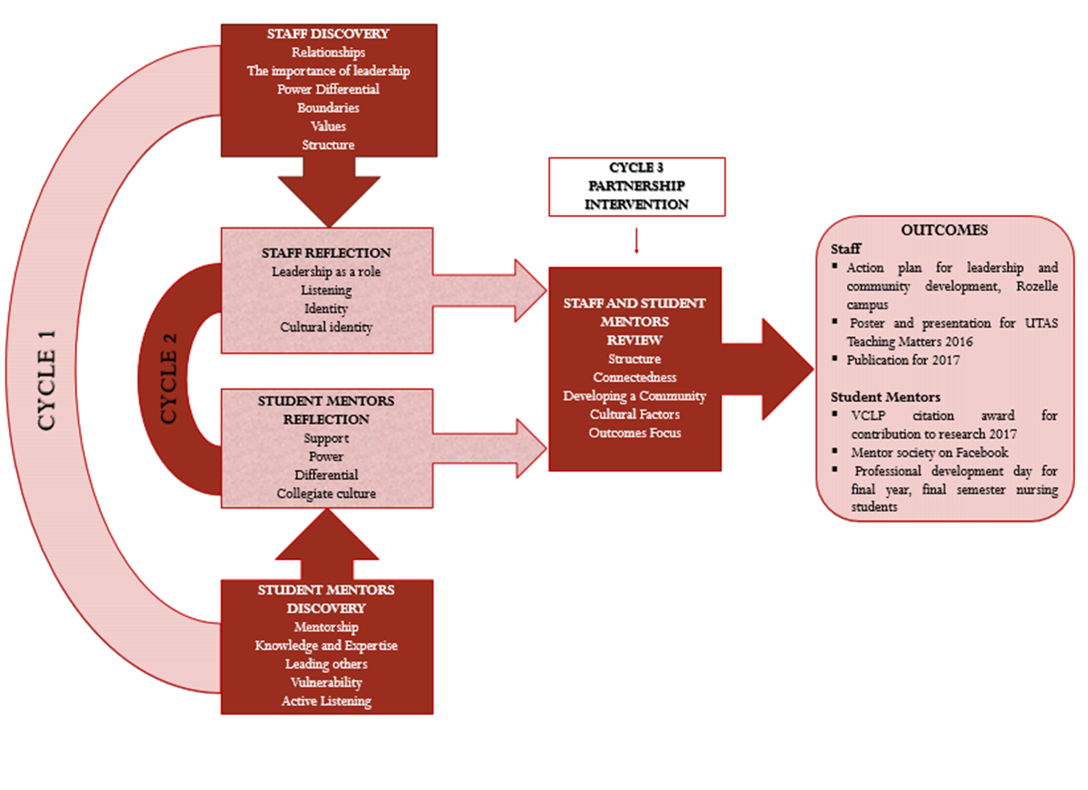
Action Research Design

Slide 4
Discovery Workshop Academic Staff Leadership – Authority, Boundaries, Power Differential, Structure
“I was thinking about myself as a leader because when you said authority I think one of the challenges in this project is to sort out the boundaries between us as teachers and leaders, and students as mentors ….. Not so much formal authority but sort of professional boundaries I suppose …”
“You have to be strategic in terms of developing relationships … I really think the structural stuff is always important when we're talking about, you know, systems of people because people aren't sitting in vacuums.”

Slide 5
Discovery Workshop Student Mentors Mentorship versus Leadership - Knowledge and Expertise
“ … when you're leading … whether you want to be a member of the top of the community to guide or help first you have to have knowledge of what you're doing. (In the Mentorship role) the knowledge is very important. You obviously have to develop the capabilities to have the knowledge … we're not all equal … we've got people who, um, have more knowledge...”

Slide 6
Reflection – Academic Staff Leadership Role, Relationships, Listening, Cultural Identity
“It's how you - it's how you engage in that relationship; whether you use it to an advantage or a disadvantage or to the advantage of both ….”
“I'm just trying to get my head around this idea where we're going to have professional relationships with people, but the power might be different within that professional relationship. I'm actually looking forward to learning a lot from the students because I know my students….”
“Nursing has a very understated culture … they do a whole bunch of leadership but they’re not forward and proud like the paramedics …”

Slide 7
Reflection – Student Mentors Support, Power differential, Collegiate Culture
“I think it’s very important because you’re basically taking a step on a path that, you know, you’re not sure about it, you don’t know what to expect especially with fast-tracked course. So you need support as much as you can get.”
“Of course there’s a respect for the knowledge base that teachers have, but I think when you’re just really okay with your humanness, that’s when that (power) differential stops.”
“Do you think that Tasmania sees English Second Language as such a big problem considering all the studies and everything they look at is in Tasmania, which doesn’t have a very diverse culture?”

Slide 8
Partnership Intervention and Review Creating Community
Paramedic Student: “I think it's all about just creating community, creating trust and belonging and feeling safe and secure and happy as part of the students and the staff connecting together.”
Nursing Student: “Well how am I meant to be in this position to be mentoring someone at a time at uni where I feel most abandoned? In the hardest point of uni this semester when we have no interaction with teachers whatsoever besides having to meet my partner we have had zero interaction with teachers, nowhere to go when we're stuck with this.”

Slide 9
Partnership Intervention and Review Cultural Factors
Nursing Student from Afghanistan: My personal experience when I first submitted my assignment was introduction to nursing I got four out of 20 … I had a medical background from overseas… we have student mentors who helped and the engagement with academics … I ended up with a distinction.”
Paramedic Student from Australia: “The first time I had the opportunity to seriously interact – it was a pub crawl that created a more social environment … coming together. Every end of semester we go out and we have drinks so maybe incorporating that into the university community ...”
Nursing student from Nepal: “Yes, (but) what's a pub crawl?”

Slide 10
Partnership Intervention and Review Outcomes Focus
Nursing Student: “So the main thing is how do we establish relationships, create a sense of connectedness and trust, a holistic campus and build a community?”

Slide 11
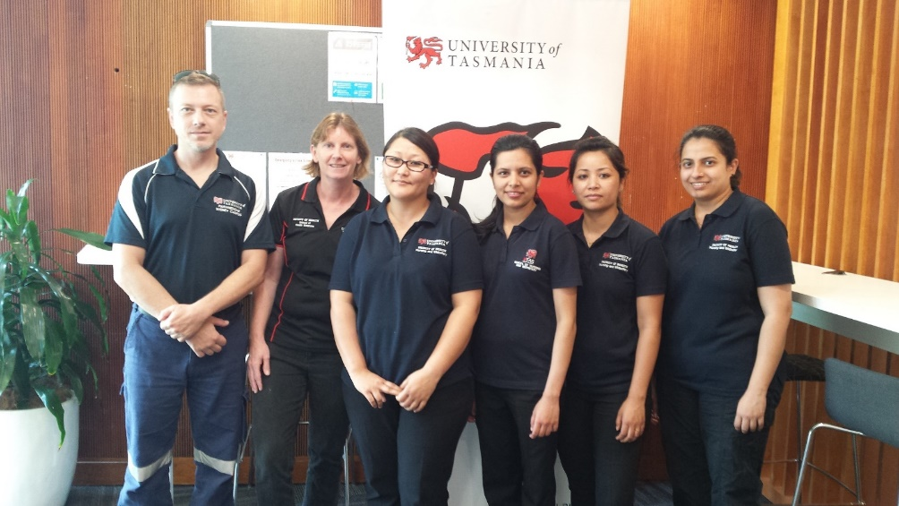
Outcomes
Staff
Action plan for leadership and community development, Rozelle campus
Poster and presentation for UTAS Teaching Matters 2016
Publication for 2017
Student Mentors
VCLP citation award for contribution to research 2017
Student mentor society on Facebook across disciplines
Professional development day for final year, final semester nursing students

Slide 12
Questions?

