Slide 1
Enhancing the sharing of learning and teaching resources at UTAS
Teaching Matters 2016
Presenters: Luke Padgett
Carina Bossu

Slide 2
About the Project
Tasmanian Institute of Learning and Teaching
A project funded via the UTAS Projects of Institutional Significance Funding Scheme
The project aimed to demonstrate that sharing learning objects at the School, Faculty and / or the University level provides for an economy of scale in the production of teaching resources, quality improvement and the opportunity for communities of teaching practice to develop.
Project team:
Luke Padgett (Project Leader)
Vanessa Warren (Project Manager)
Tony Carew (Technical Officer)
Carina Bossu (Team Member and evaluator)
LOR Champions
Project Evaluation

Slide 3
Goals and deliverables
G1 Develop a culture of sharing to foster efficient learning resource production and use, quality improvement and the opportunity for communities of teaching practice to develop
G2 Develop the capacity for our academics to enhance curriculum offerings and meet Teaching Performance Expectations
G3 Realise the benefits of sharing our teaching practices with the world
D1 Identify eight potential LOR champions (across different Faculties), and with their assistance establish a community of practice for the sharing of learning resources through the UTAS LOR within each Faculty.
D2 A repository framework for sharing learning objects that is implemented on a UTAS LOR
D3 A document containing some guiding principles on how sharing learning resources through the UTAS LOR can contribute to TPEs.
D4 A practical guide on how using the LOR to share learning objects can enhance curriculum offerings at UTAS.
D5 Develop and deliver a series of workshops with Repository Champions to engage the broader university community.
D6 A resource discovery framework that integrates with existing UTAS repositories exposing selected high quality UTAS learning resources to the world.

Slide 4
Deliverable 1 | CoP
Establishing a community of practice for the sharing of learning resources through the UTAS LOR within each Faculty proved difficult.
Heavy workload was a problem identified by all champions as a barrier to their further engagement in the project. As a result, there was minimum contribution to the repository during the life of this project.
The fact that the project team couldn’t guarantee continued support for the developed repository service after the completion of the project was an issue for some champions. It made it difficult to justify the effort involved in contributing to the scale they would have liked.
A majority of champions discussed that they would have liked to contribute many cross-disciplinary teaching modules for sharing across Schools and beyond UTAS.

Slide 5
Deliverable 2 | Repository Framework

Slide 6
Deliverable 2 | Repository Framework
Extensive research and development was undertaken in developing a repository framework that met the needs of repository users.
Formative evaluation of the project led to metadata schema refinements to licensing and relational metadata elements as well as the insertion of elements relating to subject, peer review, and learning outcomes.
Usability testing was performed by a set of participants who have never used the repository before.

Slide 7
Deliverable 2 | Repository Framework
Issues and lessons learned:
The repository’s functionality did not allow for the peer review process to be conducted within the repository. This led the project team to provide an alternative solution (this will be discussed under Deliverable Three)
The project team were unable to resolve a search issue with the repository

Slide 8
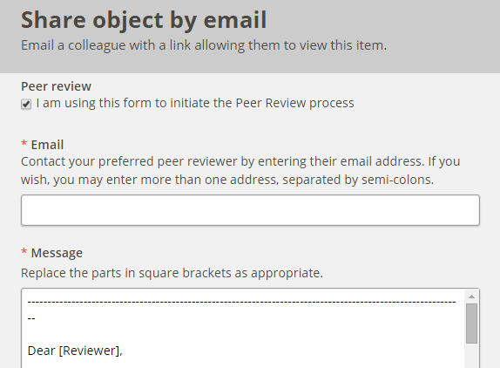
Deliverable 3 | Peer review

Slide 9
Deliverable 3 | Peer review
Integrated guidance was developed on how sharing learning resources could be recognised as TPEs.
A system was developed enabling Peer Review of Learning Objects (PRoLO).
PRoLO is a simple and automated process developed for this project to ensure accuracy, currency and quality of learning objects available in the repository.
Using PRoLO, resource creators can collect evidence that could be used towards their TPEs.
Participants found this feature of the repository innovative and attractive.

Slide 10
Deliverable 3 | Peer review
Lessons Learned:
The repository should allow reviewers from other national and international institutions to engage in PRoLO process. This will have licence implications for the repository.
There would need to be vigorous promotion and dissemination of the PRoLO process, so that academics can better understand the benefits of engaging with the repository; sharing and improving the quality of learning resources and being recognised for doing so.

Slide 11
Deliverable 4 | Enhancing Curriculum Offerings
A separate practical guide on how to share learning resources through the repository was developed.
The project team created and organised all the information as “help” and additional information available in pop-up windows.
Participants liked this approach and found that the information available to them within the repository was well organised, helpful and clear.
The team also included web links to resources about curriculum design and learning and teaching, available within the Tasmanian Institute of Learning and Teaching (TILT) website to assist participants to enhance their teaching practices by using resources available in the repository.

Slide 12
Deliverable 4 | Enhancing Curriculum Offerings
The main issues faced by the project team in relation to this deliverable were:
to develop clear and helpful instructions on how to use the repository;
how to differentiate learning objects from learning resources; and
how and which license to apply to the resources uploaded.
Project participants recommended that the project team should deliver a series of workshops to the broader university community to build capacity and raise awareness about the repository, as well as how to apply the most applicable license to their resources.

Slide 13
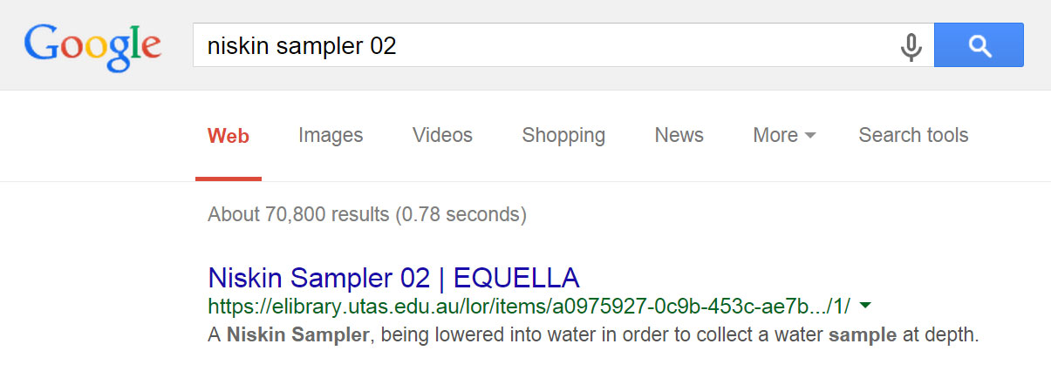
Deliverable 6 | Discoverability

Slide 14
Deliverable 6| Discoverability

Slide 15
Deliverable 6| Discoverability
Lesson Learned
Continual resourcing is required to ensure and improve discoverability of the repository. This is the type of activity that could be carried out by an LOR manager

Slide 16
Outcomes
Projects of Institutional Significance Final Report
https://elibrary.utas.edu.au/lor/items/ba0b0df5-bcb6-44dd-bca6-a56aac7f6932/1/
Project goals and deliverables:
Establish a culture of sharing to foster efficient learning resource production, reuse, and quality improvement | ~
Provide opportunities for communities of practice to develop | ✓
Develop the capacity for our academics to enhance curriculum offerings and meet Teaching Performance Expectations | ✓
Realise the benefits of sharing our teaching practices with the world | ✓

Slide 17
References
Brown, N., Kregor, G., Williams, G., Padgett, L., Bossu , C., Warren, V., & Osborne, J. (2013). Technology enhanced learning and teaching white paper 2014-2018. Retrieved 28 Aug, 2015, from http://www.teaching-learning.utas.edu.au/news/news/telt-white-paper
University of Tasmania. (2014). Divisional Plan: Students and Education. Retrieved 3 November, 2014, from https://secure.utas.edu.au/dvc-students-education-staff-only/documents/DVC-SE-Plan-2015-Final-12-June-2014.pdf
University of Tasmania. (2014). Curriculum Principles for the University of Tasmania. Retrieved 3 November, 2014, from http://www.utas.edu.au/__data/assets/pdf_file/0006/567744/7825_A3_Curriculum-Principles1.pdf
University of Tasmania. (2014). Teaching Performance Expectations (TPE) Framework. Retrieved 30 May, 2014, from http://www.utas.edu.au/__data/assets/pdf_file/0008/447443/7815A-Revised-Teaching-Performance.pdf
Balatsoukas, P., Morris, A., & O’Brien, A. (2008). Learning Objects Update: Review and Critical Approach to Content Aggregation. Educational Technology & Society, 11 (2), 119-130.

