Slide 1
XBR211 Fermented Food & Drink
Anna Carew, Gemma Lewis, Simone Bingham, Jo Jones
Simon James, Kim Backhouse, Roger Latham

Slide 2
Presentation at Teaching Matters 7 December 2016
Synergies and innovation for staff and students in the development and delivery of a Fermented Food and Drink breadth unit

Slide 3
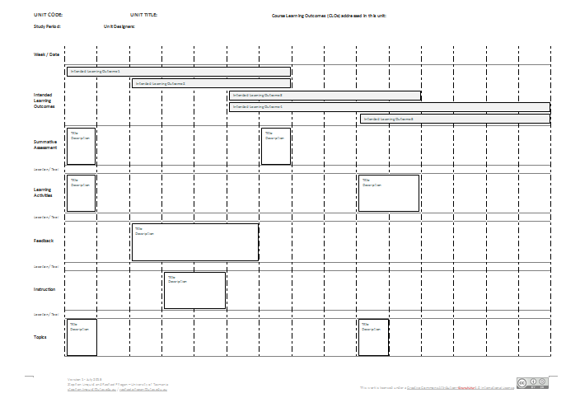
XBR211 Fermented Food & Drink – structure & assessment

Slide 4
Intensive Week Day 1 – The Shopping Begins

Slide 5
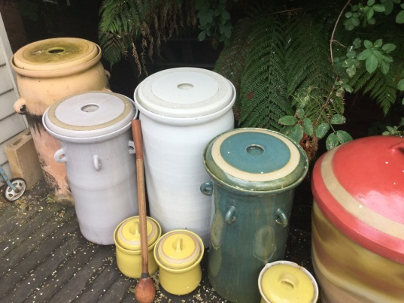
Day 1 – A visit to Adam’s house for some kimchi and miso preparation

Slide 6
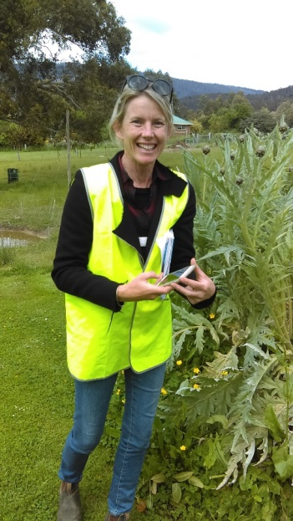
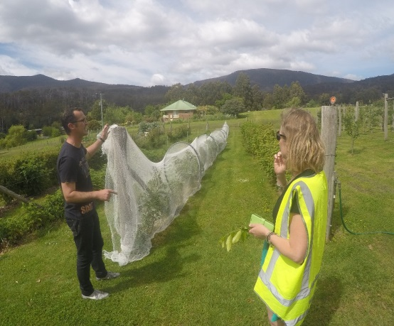
Day 2 – Agrarian Kitchen – a walk around the garden with owner Rodney Dunne

Slide 7
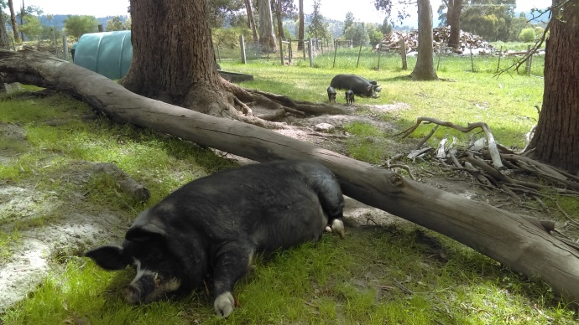
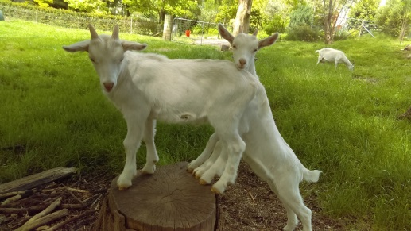
Roger befriends some of the locals

Slide 8
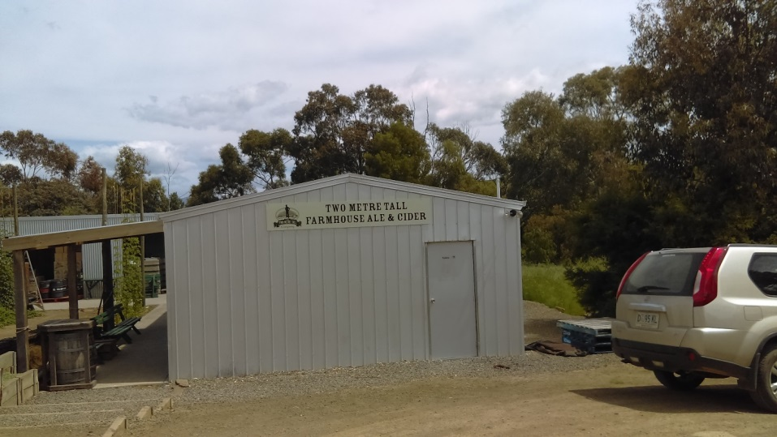
Day 2 – Two Metre Tall Brewery - Ashley Huntington explains the beauty of hops and grain

Slide 9
Day 3 – Lab Work

Slide 10
Day 5 – Nick Haddow Bruny Island Cheese Company

Slide 11
Day 5 – At the Wursthaus – Anna explains

Slide 12
Day 5 - Shambles Brewery – some reading and some tasting

Slide 13
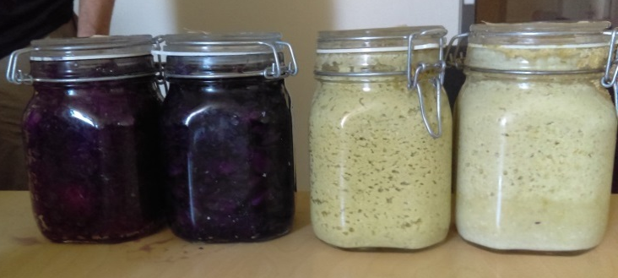
Day 5 – Our miso and kimchi; Considering the Agar Plates

Slide 14
Our Learning
Upside down unit design
Effective team selection and processes
Global and local unit focus
Work Integrated Learning
Adapting to the shock, horror and disappointment of 5 students for face-2-face week…. ☹ …and coming to terms with online teaching

Slide 15
Conclusions
Synergies and innovation for staff and students in the development and delivery of a Fermented Food and Drink breadth unit

Slide 16
Copyright notice
Copyright ©
University of Tasmania, All rights reserved.
Commonwealth of Australia Copyright Regulations 1969 - WARNING
This material has been reproduced and communicated to you by or on behalf of the University of Tasmania pursuant to Part VB of the Copyright Act 1968 (the Act). The material in this communication may be subject to copyright under the Act. Any further reproduction or communication of this material by you may be the subject of copyright protection under the Act. Do not remove this notice.

