Slide 1
The ‘IRD-Way’ through Critical Moments Reflection
Teaching Matters
7 December 2016

Slide 2
This Presentation
Background & Justification
Stakeholders
The Literature
Brookfield’s Lenses
The CMRM
Linking the Theory
Methodology
Key Critical Moments
Did it work?

Slide 3
Background
“[r]egional universities can, and should play a major role in the development of a region” and that “[r]egional universities, through their teaching and research functions, can provide both leadership and support roles within the region”
(Moore Consulting, 2005, p. 4)
“[A] new approach to knowledge and learning, characterized by interaction, participation, and inclusivity; capable of mobilizing both formal and informal knowledge together across traditional boundaries; capable of being user-generated and demand-driven”
(Allison & Eversole, 2008, p. 107)

Slide 4
Justification: The IRD-Way (10 years of dev’t)
Attempts to meet local need
Responds to Moore Consulting and Allison & Eversole
Based on Knowledge Partnering
Trialled many initiatives
E.g. ePortfolios, WIL, reflective practice, blended learning
No ‘qualified’ evidence to back it up bar staff assignments in GradCertULT and the ePortfolio project
Need to capture these ideas together.

Slide 5
Stakeholder Analysis
Stakeholder | Importance (H/M/L)
Academic peers in the IRD (current and former) | H
Director of the IRD and the PVC (CP&RD) | H
Principal of the new associate degree entity | M
Broader UTAS learning and teaching program developers, teachers and academic administrators | M
SoTL community outside of UTAS | M
Cradle Coast region (inc. current and former students) | M

Slide 6
Brookfield’s Four Lenses
So how do we look inwards and ‘hunt our assumptions’?
Brookfield identifies fours lenses into which
Autobiographical Experiences of Learning
Learner’s Eyes
Our Colleagues’ Experiences
Theoretical Literature
However, we have had a 10 year journey not a short, defined period
The horizon is a larger, co-delivered teaching program and not a single classroom environment
What now? The Critical Moments Reflection Methodology

Slide 7
Four Stages of the CMRM
A methodology that is based on the identification of critical moments (or critical events) in time and reflecting on their meaning and learning
(Ferreira, 2008, McDowell et al., 2005)
Develop inquiring questions
Identify critical moments
Develop a timeline
Analyse timeline and unpack stories

Slide 8
Linking Lenses to the CMRM

Slide 9
Testing of the CMRM in this project

Slide 10
Methodology: The Participants
Criteria
Current or former academic staff members of UTAS
Acted as an IRD unit coordinator for at least two semesters
Taught into an IRD teaching program
11 current and former staff members met this criteria
Participants
2 x current level E
1 x current level D
1 x current level B
1 x former level B
1 x current casual

Slide 11
Methodology: Ethical Considerations
This was quite difficult to navigate
Key issues to address:
Potential coercion
Perceived bias
Recruitment
Anonymity

Slide 12
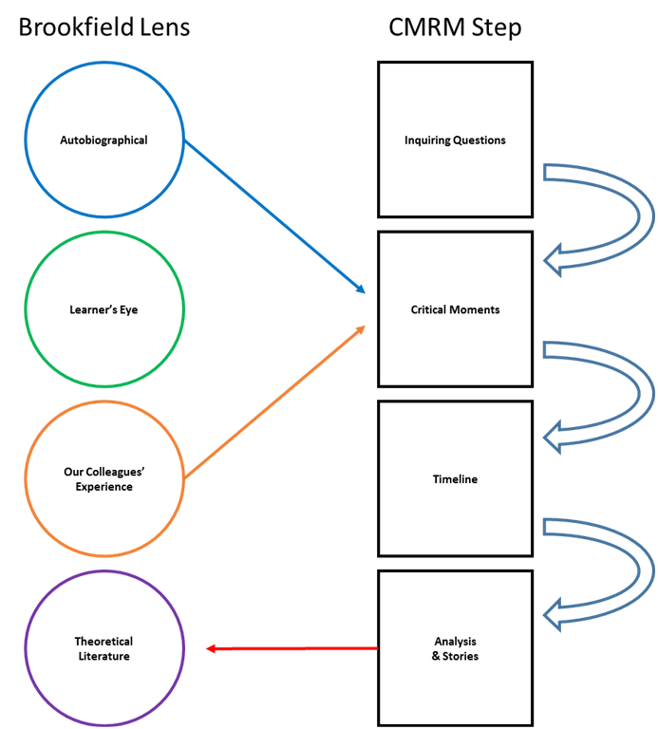
Methodology: The Process
Stage One: Self-reflection
Stage Two: One-on-one interviews
Stage Three: Group workshop

Slide 13
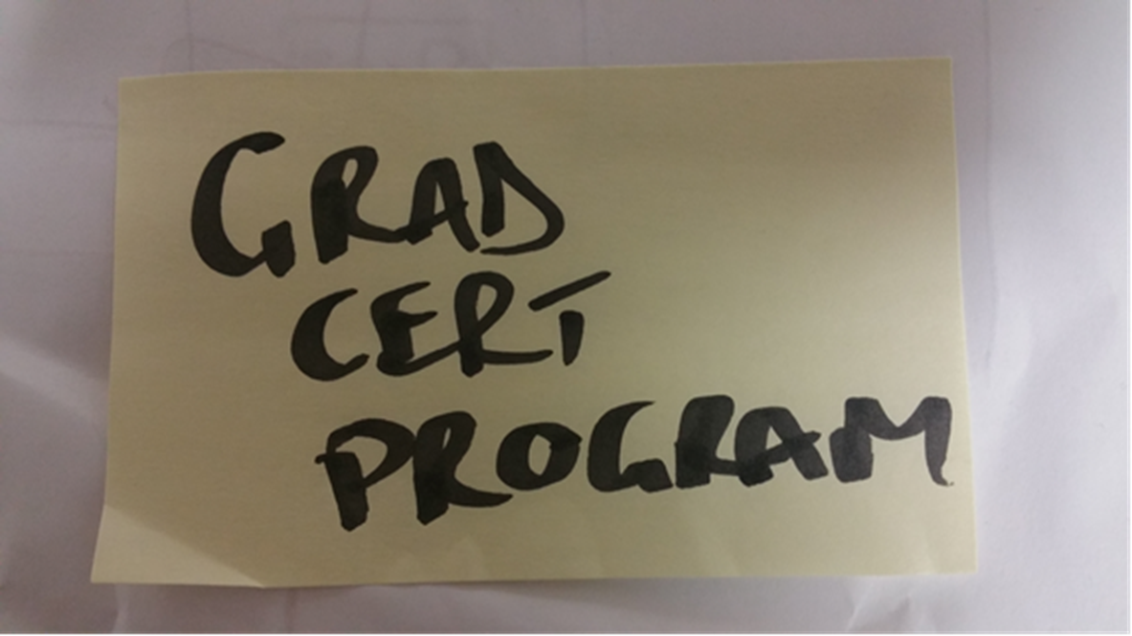
The Timeline Pre-Session
Self-reflection and one-on-one interview material collated to identify critical moments
Stepped workshop participants through critical moments

Slide 14
The Timeline with Sticky Notes

Slide 15
Key Findings
A key finding was that we could group the CMs into ‘eras’
Eras:
Creation of the IRD and BRRM
DASA & GradCertBus
Post-DASA consolidation
New Directorship
Key critical moments:
Creation of IRD
Implementation of BRRM
First Director of IRD
‘Pracademics’
ePortfolios + RegSci Toolkit
First PhDs
Knowledge Partnering
GradCertBus + BAA506
Second Director of IRD
Mount Roland Project
End of BRRM
GCertLeanMgtSys
Breadth Unit XBR202
Associate Degrees

Slide 16
Did the Methodology Work?
Positives:
Captured information
Collegial activity
Limitations:
Some moments were not actually ‘moments’ per se (they were eras!)
However, this is an interesting finding!
Individual interviews were time consuming
Key Learning:
Individual interviews not required. Bring the people together.

