Slide 1
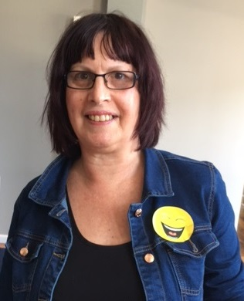
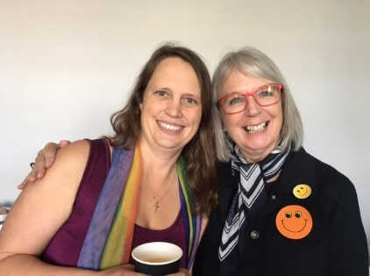
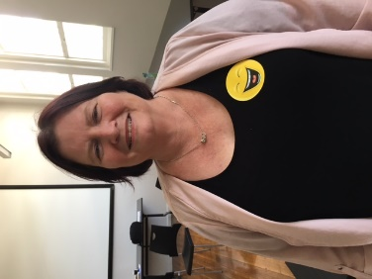
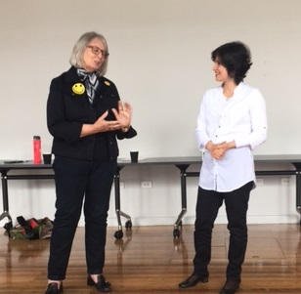
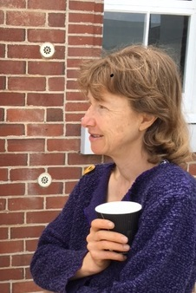
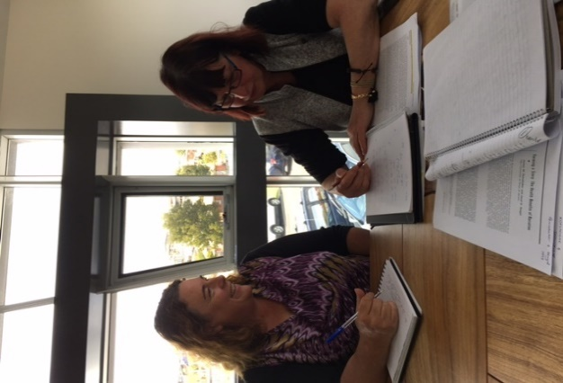
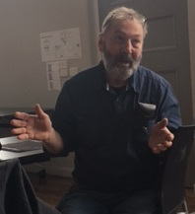
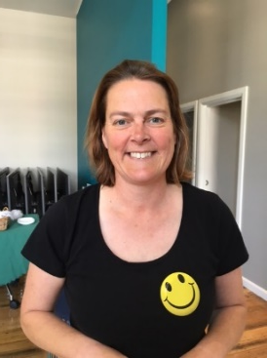
Peripherality, Place and Possibilities
Presentation by:
Melissa Finnen
Merete Schmidt
Peter Brett
Teaching Matters
December 7 2016
Notes:
Introduction of presenters – perhaps point to them on group picture on next slide?

Slide 2
Our Journey
We would like to share our journey from PLC to CoP, highlighting how we have built relationships and intellectual bridges to strengthen individual and campus aspirations as we strive to continue to maintain excellence in teaching as a united group at the Cradle Coast campus.
Notes:
We would like to share our journey from PLC to CoP, highlighting how we have built relationships and intellectual bridges to strengthen individual and campus aspirations.

Slide 3
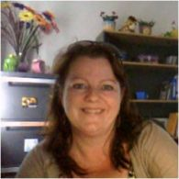
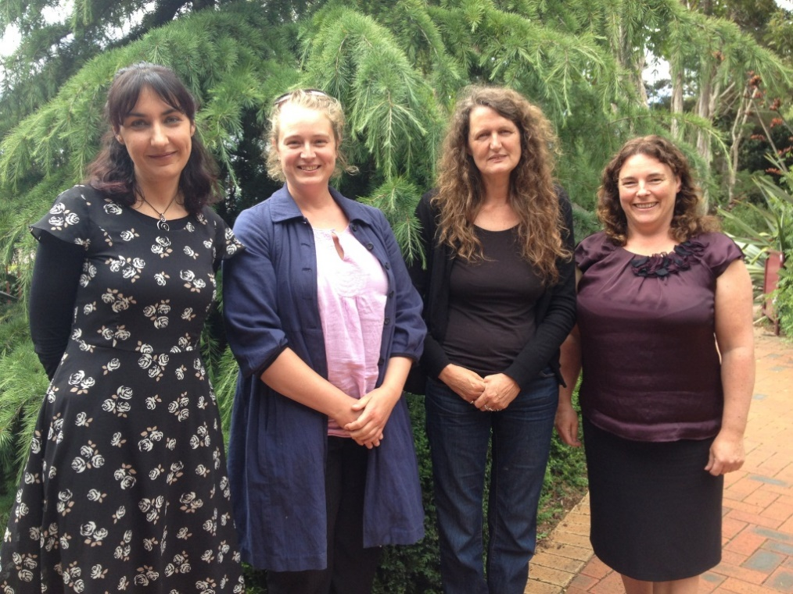
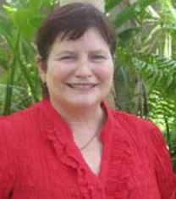
What came first?
The Peer Learning Circle (PLC)
Notes:
In 2015 Christine Padgett and Merete Schmidt applied for a PLC grant in an attempt to overcome the ‘working in silo’ culture at the Cradle Coast campus. Because of the geographical isolation of the campus and its small size we felt there was an enormous need for a space where staff members could meet and discuss teaching and learning practices.
In PLC meetings we shared our experiences of working at a small rural campus
We also shared assessment tasks and discussed which tasks worked well and which didn’t for the Cradle Coast students
At the end of the year a need to establish a more formal space in which academics could meet was identified.

Slide 4
Personal Reflection: With thanks to Associate Professor Robyn Eversole (Director: Institute for Regional Development)
Notes:
Personal reflection by Associate Professor Robyn Eversole ( Director for Regional Development) – 41 seconds approximately

Slide 5
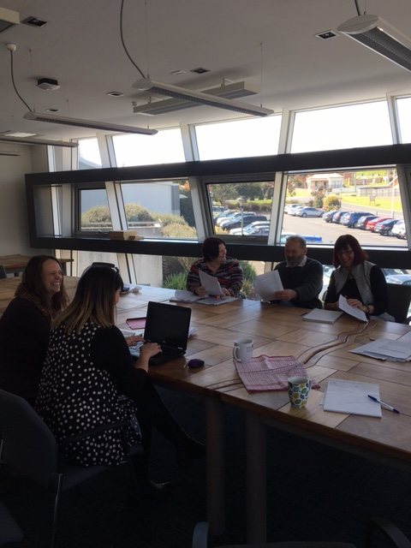
The next step was the formation of?
The Cradle Coast Academic Community of Practice (CCACoP)
Notes:
The CoP idea was born and particular themes which would be useful to explore in the CoP was identified:
Student engagement/support
Developing assessment tasks
Research opportunities – eg Learning and Teaching in rural areas, application of new assessment tasks
The Cradle Coast Campus Academic Community of Practice was formed early this year. It is a group of academics based at the University of Tasmania’s Cradle Coast campus in Burnie.
We share common experiences of the opportunities and challenges involved in conducting research and teaching on a small rural campus

Slide 6
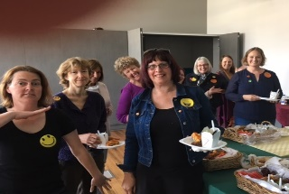
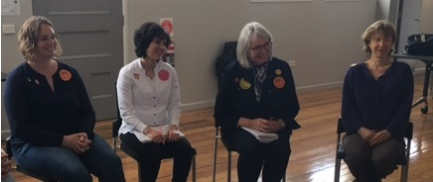
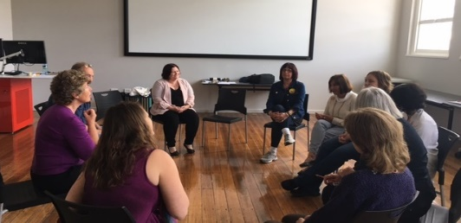
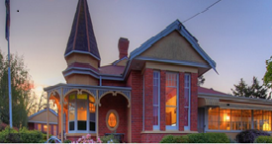
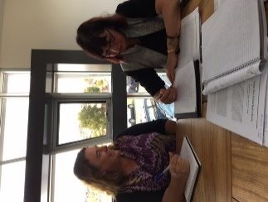
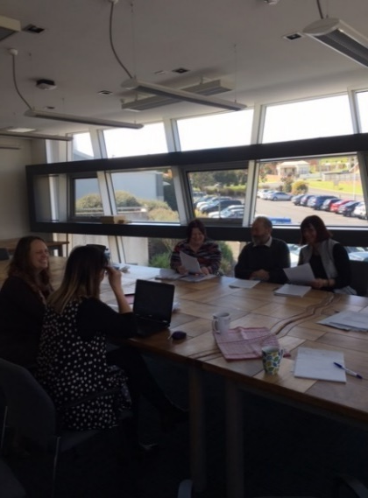
The Cradle Coast Academic CoP Experience
Writers Retreat
Book Creation
Objectives
An inclusive and dynamic environment which embraces change and flexibility
Mutual learning and information-sharing
Research development support
Teaching development support
Activities
Monthly CoP meetings
Successful application for an $8000 Career Development Grant
Book creation process
Two days writers’ retreat
Weekly writers’ group
Participation in the Regional Researchers’ Network
Engagement with the UTAS theme ‘Data, Knowledge, Decisions’
Barbara Warren workshop
Presentation at Teaching Matters
Outcomes
A collaborative environment with a higher degree of mutual learning and information sharing
Strengthened research performance
Strengthened teaching performance
Expansion of academic networks through monthly CoP meetings and participation in Regional Research Network Events
A collective voice/advocacy role
Notes:
Objectives
We knew from the PLC activity that a more collaborative, inclusive and dynamic space was needed at the Cradle Coast Campus.
We specifically wanted to create a collaborative environment which could provide more opportunities for staff to learn from each other and share information. On larger campuses such opportunities are provided on a School level but on smaller, rural campuses such as the Cradle Coast we can’t take this kind of interaction for granted because often Schools are represented by individual staff members who work in isolation
We specifically wanted to set up this collaborative environment to support people’s research and teaching activities. Opportunities for career and professional develop are often difficult to access on small campuses and part of the objective for establishing the CoP was to overcome this
It was very important for us to make sure the CoP was inclusive and always open to new members. Wiki was established with monthly meeting agenda and minutes. Important information placed on Wiki. Emails and calendar invites distributed for every event. News published in the campus newsletter.
Activities
A collaborative space was established through monthly meetings. Additional workshops, meetings, activities were also organised
The collaborative nature of the CoP is especially manifested in our book project which Peter will talk more about.
As you might remember in the PLC we identified subthemes which were relevant to staff and their areas of work. We started working with these themes at the beginning of the CoP. However, another idea developed which members embraced – the book idea. Working together on this book has helped the CoP form and members to interact. CoP members have probably benefitted more from working on this book than splitting up into subgroups. This is a good example of how our objectives: inclusion, collaboration and a dynamic approach, has resulted in progress and innovation
Outcomes:
We have successfully created a collaborative space. The formal meetings and activities have supported informal interaction. For example, staff are now more likely to stop in the corridors and ask ‘do you know there is an information session on this’ or ‘do you know this research’?
Staff have increased their research performance. Working on book together. Part of this process has been to share writing and publishing strategies. Workshop with Barbara Warren has developed our public speaking skills. People are starting to form other research collaborations.
Staff have increased their teaching performance. Being aware of practices in other disciplines (Mel will talk about this). Sharing assessment practices. Improvement in teaching practices will improve the learning experiences of students at the Cradle Coast campus and support them in their transition to university, supporting student learning outcomes. Providing this support is particularly important in a region characterised by low SES, high rates of early school leaving and high numbers of students who are the first in their family to attend University.

Slide 7
What the Cradle Coast Academic Community of Practice has meant to me?
I walked the corridors for five years smiling at ghosts. Now the ghosts have materialised into colleagues….
…..with benefits
Notes:
My story that I would like to share is something may sound familiar to a number of you and can easily be transferred to larger campuses. Originally, I was employed at the Cradle Coast campus as an Associate Lecturer in the Pre-degree space as a casual employee. As a casual and further along the track a sessional staff member I would come onto campus a couple of days a week for several hours. What I noticed over a period of time was that quite often I would pass the same person in the hallway who would smile or nod as we walked pass each other…………… and I was really unsure whether they were staff or students. Or you would know a person by name but necessarily know their face.
In addition, even though the Pre-degree team were great and supportive, I very rarely saw them as the times I was on campus they were generally teaching. Therefore, to some extent, the workplace felt quite impersonal and at times lonely because I missed the collegial conversations that I was used to having with peers in the staffroom in bigger institutions. It was difficult I felt to find my place in the campus community and at times to find my feet although the people I saw seemed nice. Simple questions at times were left unanswered until the next time I was on campus or took time to seek out the answers, which can be at times quite frustrating. The CoP has made a significant difference because the ‘smiling ghosts’ have become colleagues, friends and a support network, but more importantly through the dialogue that has occurred from the very first meeting it has put the ‘fun’ back into the workplace, it feels like I belong and I feel like I can make a difference to the Cradle Coast campus community.

Slide 8
The Benefits:
Humanised the workplace
Expanded teaching horizon
Workplace has become more collaborative
Greater access to different channels
As a result I feel I have greater opportunity to pay it forward because I:
Am part of the wider teaching and learning fellowship
Have greater confidence to give back to the campus community and my peers as I feel I have a voice with the support of the CoP
No longer feel isolated
Notes:
Ultimately, through the Community of Practice I feel that the connections made and the collegial sharing of best practices through both formal and informal conversations has reinforced my teaching as well as expanded on my knowledge bank of:
What works well
What does not work well
Possible solutions / resources that I can tap into to improve my teaching practice
For example, in one of the earlier meetings there someone mentioned they would like to improve their notification systems on MyLO and in particular an easier way to track students attendance/participation. This was something I too was not sure how to do. Another colleague volunteered that they were using ‘intelligent agents’ that they simply add into the MyLO system that not only can track what students have / have not done it can send out instant notifications to students who may not have completed the quiz or who have missed 3 lectures in a row. Problem solved very easily and the staff member was able to demonstrate how this works very simply and easily.

Slide 9
Personal Reflections: With thanks to Mike Harris & Lynette Ireland
Notes:
Personal reflections by Mike Harris and Lynette Ireland in regards to what the CCACoP has meant to them –approximately 1 minute 15 seconds.

Slide 10
What does this Mean?
Ultimately, across the Cradle Coast campus and, to some extent the state, the students we teach are reaping the benefits from the CCACoP collegial conversations that staff now have the opportunity to participate in as we strive to continue to maintain excellence in teaching as a united group.
Notes:
Ultimately, across the Cradle Coast campus and, to some extent the state, the students we teach are reaping the benefits from the CCACoP collegial conversations that staff now have the opportunity to participate in as we strive to continue to maintain excellence in teaching as a united group. Meaning ultimately quality learning outcomes for our students.
The focus I feel has shifted from individual learning and teaching goals to now having strong connections to the learning and knowledge base of the Cradle Coast campus community as a whole.
Opportunities to learn from colleagues have arisen as knowledge and expertise is shared and multiple solutions to problems are generated
Collaboration promotes change beyond individual classrooms, resulting in whole campus improvement; when educators increase their expertise by learning together, and ultimately all students benefit.
If teaching is to be alert to cross-disciplinary and trans-disciplinary opportunities then teachers need to be aware of what others are doing and others’ areas of expertise. And everyone’s teaching is enriched through a developing a deeper understanding of the place and region in which they work and of the lived experience of the people – students, colleagues, and community members – who we interact with daily. (Peter Brett)

Slide 11
New directions for 2017
Development of sub groups
Development of advocacy role
Greater attention to strategic development at the Cradle Coast campus and the broader region
Application for funding to support the CCACoP
Notes:
Sub-groups: focus on what members are particularly interested in and the development of specific groups
Advocacy role: the CoP has advocated for activities and events to be held at the Cradle Coast Campus and not just on the major campuses. Many events which were only scheduled for Launceston and Hobart have been conducted at the CC too this year.
Strategic development: the campus has a disproportionately high number of staff on casual and short term contract. The CoP will raise awareness of the negative impacts of this for the campus, for staff members and for the broader region and advocate for more permanent positions.
We will focus more specifically on opportunities for multi-disciplinary research and engagement with strategy development and advocacy related to important local issues. North West Tasmania has very low educational completion rates and high unemployment rates. Collaborative research might make an important contribution to growing a strong and sustainable community where individuals feel valued and respected.

Slide 12
Reference List
Eversole, R. 2016. Regional development in Australia: being regional. Abingdon, Oxon New York, NY Routledge
Wenger, E. 1998. Communities of practice: learning, meaning and identity. Cambridge: Cambridge University Press
Wenger- Trayner, E. and Wenger- Trayner, B. 2016. Introduction to communities of practice: A brief overview of the concept and its uses.
http://wenger-trayner.com/introduction-to-communities-of-practice/. Accessed 1 November 2016

