Slide 1
Creating Successful Staff-Student Partnerships in an Online Learning Environment
Cook, A., Ward, D., Canty, A., King, A., & Goldberg, L.R.
The Bachelor of Dementia Care program
Notes:
About the Bachelor of Dementia Care program…

Slide 2
CAD304: Negotiated Project in Dementia - “Capstone” experience
This unit will involve students selecting a research topic related to dementia for a major assignment and related presentation. The subject area will be negotiated with the academic staff contributing to the unit, and will involve a literature review and analysis and synthesis of research in this area. Students will be required to present their project verbally, and to respond to questions and comments in the online environment.
On completion of this unit, you will be able to:
Engage in an effective collaborative process to discuss research, develop ideas, and respond to questions.
Conduct independent and self-directed research into a topic of importance relating to dementia
Collect, integrate, and interpret relevant scientific literature from a range of sources and formats.
Communicate information relating to scientific literature at a high level in both written and spoken forms using appropriate academic skills and conventions.
Unit was first offered in Spring Semester [Extended], 2015/2016
61 students completed the unit
HD | DN | CR | PP | NN | Other | Total
12 | 23 | 23 | 2 | 1 | 12 | 73
Notes:
Unit description
Intended Learning Outcomes
First offered in SS[E] of 2015/2016

Slide 3
Learning Strategies & Resources
There were no formal recorded lectures, tutorial sessions or collaborate sessions.
The negotiated project nature of this Unit meant that there was no single specific reading applicable to all students.
Advice on how to approach and complete the assessments tasks was made available in MyLO, but identifying appropriate reference material remained the responsibility of the student.
12 “research-specific” staff worked with students – individually and in small groups - to assist them in clarifying their area of interest, research question, literature search, and presentations
Notes:
Students were made aware of all of this information in the “introductory lecture” for the unit, in which they were also advised of our expectations of them:
Specific Attendance & Performance Requirements
For you to pass this unit, you must:
complete all assessment tasks specified within the unit outline
complete work according to time specifications outlined in the unit outline
achieve at least 50% of the total marks available for the unit
actively participate in online activities as required.
You are expected to work towards completion of the assessment tasks in a self-directed manner and to be responsible for meeting due dates and participating online when required.

Slide 4
Learning was scaffolded through progressive Assessment Tasks
Assessment task | Weighting | Comments
AT 1: Research Development and Proposal | 10% | Student develops own question related to broader topic, with guidance from research expert & discussion forums (Weeks 1-2)
AT 2: Systematic Literature Review | 30% | Review literature to specifically answer research question
AT 3: Narrated PowerPoint Presentation | 40% | Present overview of AT2, but with a focus on extending the results/conclusion to produce a forward-looking presentation suggesting pathways/barriers to translation
AT 4: Online Participation | 20% | Asynchronous symposium based on AT3 presentations, with students asking questions of their peers, who provide answers
Ongoing online dialogue between students, research experts, and the UCs from AT1, AT2, and AT3
built confidence in preparing for AT4

Slide 5
Research Development & Proposal (AT1) Academic – Student interaction
ST: I have chosen the topic relating to … FTD due to my family history … and my current work in a severe dementia unit, where 50 % of the residents are diagnosed with FTD. … I need to conduct further research into …
R1: Great post! [emphasis in original]. It’s interesting that …
LEC: That’s really interesting that so many people in your family are diagnosed with FTD. Do you think this is because … . So looking at all that I think that your proposed topic would be really interesting.
ST: Here I am going to answer [lecturer’s] question … . Thanks [lecturer] and [R1] for many questions, answers, comment and suggestions.
LEC: I hadn’t thought of that- but yes- I suppose because FTD has … . Do you have younger people as well?
ST: Yes [LEC], the youngest is 42, and many people between 46 and 60. … Looking forward to continuing the preparation for my “research proposal”
R2: Hi, I found a couple of additional references that support your discussion points. … Best of luck with your research proposal.
ST: ... Thank you very much for the additional references. … .
R2: … I have a habit of reading far too much … and now I have passed my habit onto your, so sorry about that and … ! [emphasis in original]
ST: Ooo, do not apologise, everything is right. You did the best thing and thank you. … I do the same like you (reading, reading). … Thank you again.. We are keeping in touch and we will support each other!
Notes:
https://mylo.utas.edu.au/d2l/le/115752/discussions/threads/546529/View

Slide 6
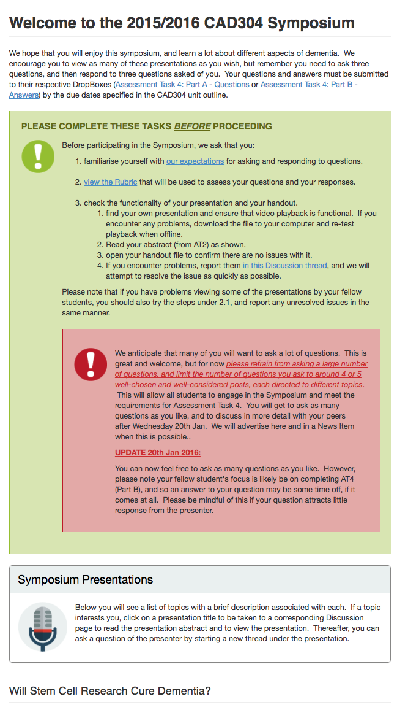
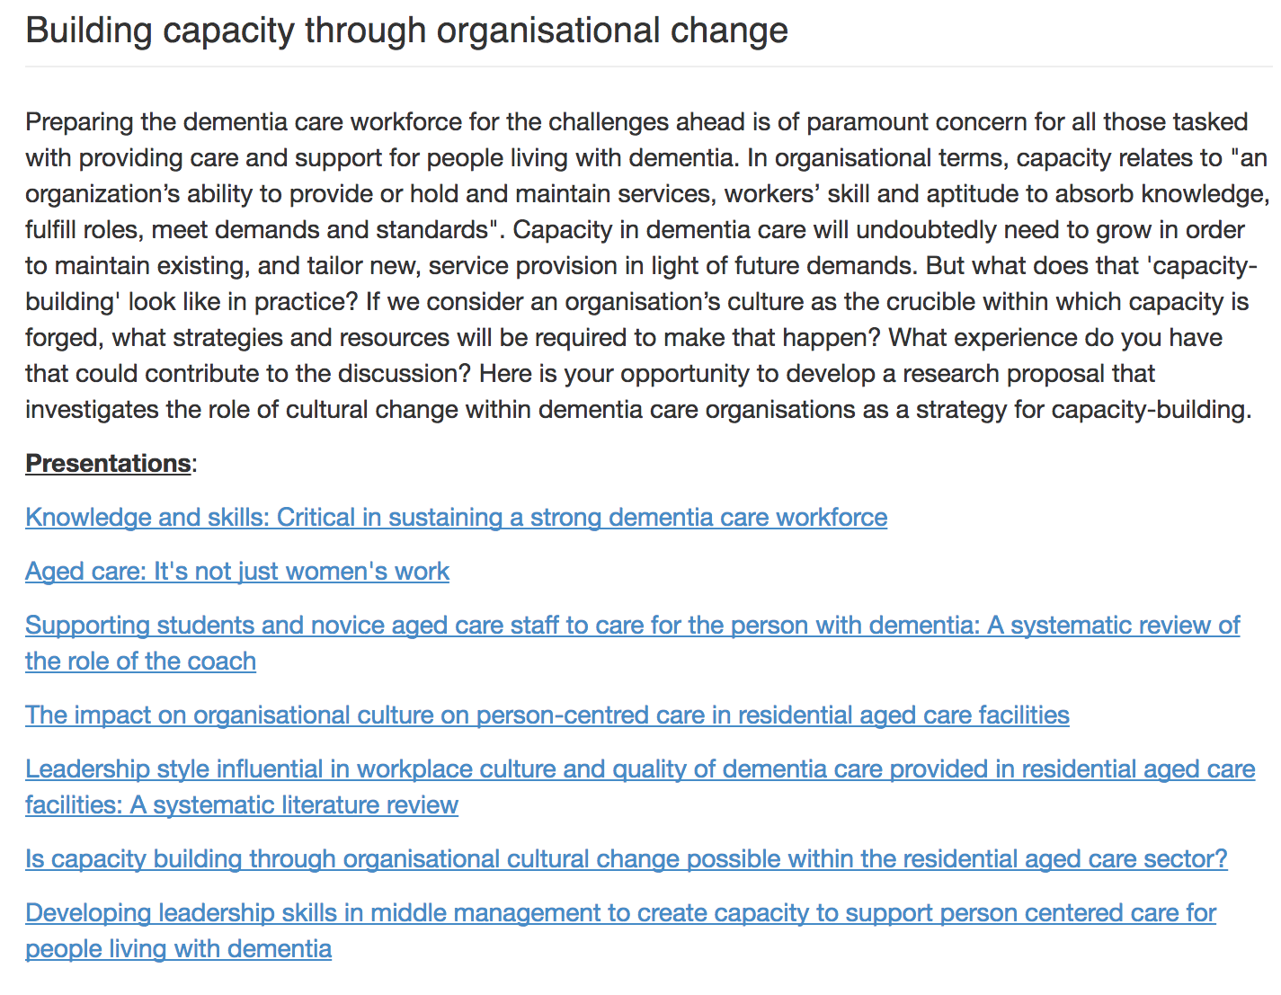
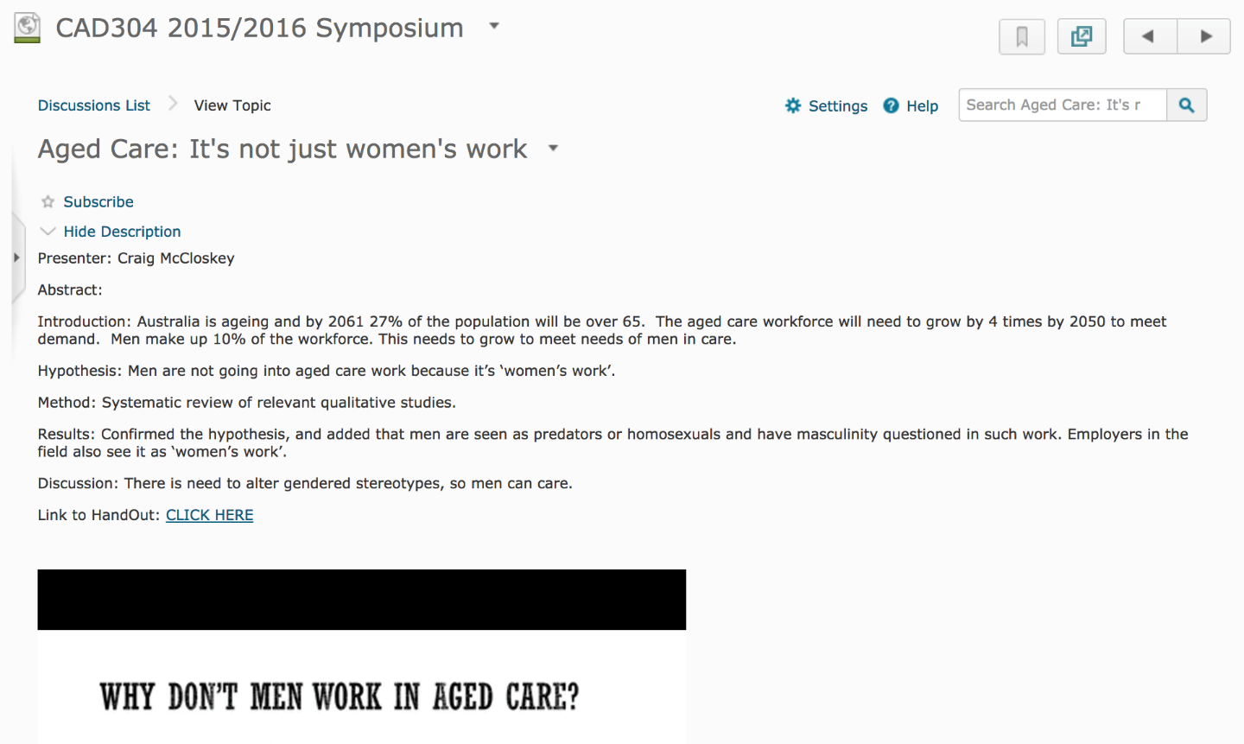
PowerPoint Presentation (AT3) and Asynchronous Symposium (AT4)
Topic and topic descriptor (also used to advertise at start of semester)
Title as links to discussion forums for each presentation
Abstract from AT2
Slides as a student handout
Embedded presentation for viewing
Viewers ask a question by initiating a discussion thread

Slide 7
Qualitative eVALUate Data - most helpful aspects
The interaction with others and the Q&A assignment. I really liked this aspect of the unit
The symposium was a good learning activity. … The questions from peers came from a different perspective than that of unit coordinators which assisted my own learning.
Learning with fun has helped me to keep knowledge I've learned permanently in my hippocampus.
The interaction between students also helped to consolidate learning by the necessity to formulate replies. Reading discussion posts and listening to other students also broadened my knowledge of the various topics.
I LOVED that we were teamed with professors etc. that had an interest in the area of focus & I, personally, found this very enriching. [emphasis in original]
WOW, by far my favourite unit. I loved the way there were no lectures and we had to research everything for ourselves. I loved the way we could make it our own, but still have some guidance & support along the way if we needed it. I loved the way we had to chose our choice of topic and still find some direction within the topic. I loved the assessments and the different stages of the assessments and what they led to. This unit has given me so much direction is which career paths I am interested in for the future. [emphasis in original]

Slide 8
Qualitative eVALUate Data – how this unit might be improved?
We were flying in the dark a lot at the beginning.
When selecting a project the lecturer who is involved in that topic be more on hands [sic]
The self-directed design of the learning and assessments left my personal learning experience as a little quiet- I was glad for the support of my peers in discussion rooms, however … I felt a little lost at times.
… More help offered to students at the start of the unit to formulate the research proposal and ideas for the systematic literature review. … Very disappointing to see the group teacher/lecturer would interact with some students more than others
Some more interaction with the 'tutor/leaders/experts' at the beginning of the semester would assist students to set up their projects.

Slide 9
Outcomes – non-solicited discussion posts
Good:
Is it possible to leave the presentations & discussions open to view after the end of semester? I think that they are a great resource. I fear I will not have enough time to view them all before they become unavailable. I would like to thank you both and congratulate everyone for a very interesting, interactive learning experience.
Better:
I would like to say Thank you for this unit. I have to say I have found this unit the most challenging and realise how I am living in such a structured world that given the opportunity to research in a non-structured format I was challenged immensely.
Betterer:
Firstly I have enjoyed this unit immensely and … . The reason for this discussion post though is that I am interested in possibly commencing a study into … [describes project and seeks advice]
Best:
Does the Bachelor of Dementia Care lead to improved care of persons with dementia, their families and their carers?

Slide 10
Acknowledgements
Unit Coordinators:
Dr David Ward and Dr Tony Cook
Unit Developed by:
Dr Tony Cook, Assoc Prof Alison Canty and Dr David Ward
Research experts:
Dr Karin Mathison
Dr Shannon Klekociuk
Professor Fran McInerney
Dr Lila Landowski
Dr David Ward
Dr Alison Canty
Dr Juanita Westbury
IT Support:
Rob Crouch
Dr Jenna Ziebell
Dr Anna King
Assoc Prof Jane Tolman
Dr Maree Farrow
Dr Tony Cook

