Slide 1
Student Peers as Partners in Learning
Student Learning, Retention and Success Teaching Matters - 7 December 2016
A/Prof Jane Skalicky
Dr Andrea Carr
Ms Kristin Warr Pedersen
Ms Sally Fuglsang
Dr Harriet Speed

Slide 2
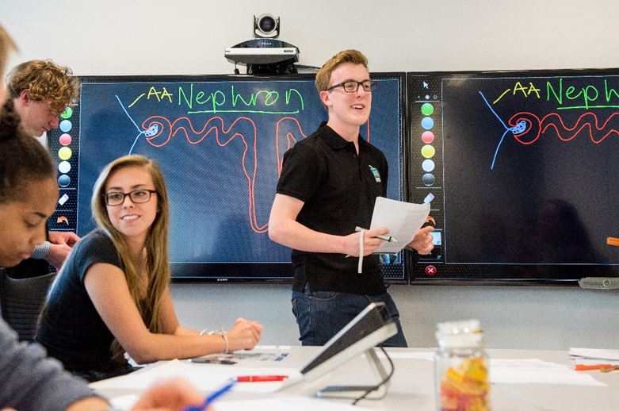
Peer-based Mentoring and Learning
Peer-based mentoring and learning are well-established, evidenced-based support strategies that can enhance the academic, social, personal and career outcomes of students.
Peer mentoring is a mutual way of learning, allowing both participants to develop transferable skills that will help them during their time at university and beyond.
The experience of mentoring and learning from peers develops a sense of collegiality among students who consequently feel more positive about their learning
The role of Peer Leaders and Mentors is to provide a “nurturing, trusting, honest environment in which the learner will grow and develop confidence, self-esteem, independence and lifelong skills relevant to study and/or work.
Peer mentoring, when supported, provides opportunities for student leaders/mentors to:
develop leadership & management skills;
improve communication & personal skills;
reinforce their own study skills; and
enhance their employability
Student peer mentoring and learning are fundamental to a range of academic support programs for students at the University of Tasmania

Slide 3
UTAS Student Peer Programs
The Peer programs are evidence-based and underpinned by quality assurance and evaluation housed within the Developing and Supporting Student Leadership (DaSSL) Framework.
DaSSL Framework developed specifically for student leadership so as to enable better informed strategic decision making and reflection on and improvement of student and peer-led programs.
Intended to enhance our ability to: DaSSL’s 5 Ps Framework
Build institutional capacity for student leadership development
Embed evidence-informed evaluation in practice
Position programs strategically to promote sustainability
Components of the Framework
Reflection Tool and Action Plan
Good Practice Principles and Guidelines
Supporting Resources
Case Studies
DaSSL Website: www.dassl.edu.au
Purpose
Progress
building capacity for developing
student
leadership
People
Practice
Positioning

Slide 4
Student Peer-led Study and Learning Programs
PASS: Peer-Assisted Study Sessions
A non-remedial, student-led and student- focused approach to learning which empowers students to take control of their learning under the guidance of senior peers, the PASS Leaders (N = 52 in 2016).
Provides students with supportive and collaborative learning environments in which students work with peers to revise course content, develop and practice relevant study skills and build social networks.
PASS Leaders are trained to give ownership of the learning process to the students.
PASS Leaders are trained and supported in their roles through a cross-disciplinary teaching approach.
Student Learning Drop In
A peer-facilitated, casual drop-in service that provides students with opportunities to develop their academic and study skills.
Staffed by Student Learning Mentors (N = 20) who have achieved exemplary outcomes in their own courses of study.
Students receive assistance with matters such as assignment planning and preparation, referencing, academic writing, exam preparation and study skills.
New initiatives in 2016 – Drop In for English and Riawunna Drop In spaces.
Now available on all the UTAS campuses
Drop In also offers a weekly online web room which is particularly beneficial to those students studying by distance.

Slide 5
Student Peer Leader Programs
International Peer Leaders (n = 5)
Faculty-based, international student peer leaders with 100% international student focus.
First point of contact providing advice, referral and resources to students.
Peer Leaders are international students with first hand experience of studying in foreign country & engaging with local communities.
Student Engagement Leaders (n = 19)
SELs plan, promote and facilitate events and supported activities that enable students to interact with each other and with the broader community to build strong social connections and networks.
Examples of activities include: Orientation Expo and Welcome dinners, Human Library, Harmony Day, UniMates, Cooking on Campus, tree planting on Bruny Island.
Career Peer Drop In (n = 7)
Career Peers are trained to work with students to identify and articulate their skills and experiences through their resumé, via:
a student drop-in service
online Resumé Check and Resumé Plus
Also support students with job searches and job applications
Other Peer Leaders at UTAS
Roving Information Officers
Transcription Officers
Peer Notetakers
Student Success Officers (see next slide)

Slide 6
Student Peer-Led Support Programs
Student Success Interventions
Support students at risk of disengagement from the University
Pro-active, data driven approach complemented by direct referral from academic staff
6 trained student peer leaders – Student Success Officers (SSOs)
SSOs provide phone and email contact and follow-up support (SMS to be added in 2017)
Student Cohort Interventions:
Welcome to UTAS
Late Commencement
CALD Welcome
Distance (off-campus)
Academic Progress Review (APR)
International Student Non-Attendance at Orientation
Unit-Based Interventions
MyLO Access
Non-submission of Assessment
Failed Assessment
Class Attendance
Pre-Exam Check

Slide 7
PASS: Peer-Assisted Study Sessions
In 2016, PASS supported 41 units Sem 1 and 38 units Sem 2
Across all main Tasmanian campuses & online
52 high-achieving students employed and trained as Mentors
Approximately 2,000 PASS sessions were offered to 6,200 students
In total, 2,200 students in PASS supported units attended PASS sessions, for between 1 and 12 sessions.
This corresponded to approximately 13,000 contact hours (1:1 contact).
Overall, students who attended PASS performed better than students who did not attend (see figure).
In 2015, the retention rate from Semester 1 to Semester 2 for students who attended PASS was 96% compared to 91% for students who did not attend PASS.
Analyses of PASS data for all 2015 and for Sem 1, 2016 indicated that:
Pass attendees performed, on average, a full grade better than non-attendees
The unit results for students who attended PASS were on average higher the more sessions they attended.

Slide 8
Student Learning Drop In
Drop In visits by students have increased dramatically (overall 300%) across all campuses in 2016 compared to 2015.
In 2016, 757 students attended 1,478 Drop In visits over the year.
Approximately 1/3 of Drop In visits are from International Students with English as a second language. Now have Drop In for English.
Students from Faculties of Health and Arts made up just over 50% of Drop In visits
Main reasons for Drop In visits:
essay & report writing
reflective writing
assistance with group projects
English skills
exam preparation

Slide 9
RETENTION: Student Success Interventions – Semester 1, 2016
Semester 1, 2016 contacts totalled 5,851 emails and phone calls to 3,077 students; broken down into email plus attempted phone contact (n= 1,913 students), and email plus successful phone contact (n=1,164 students).
The number of student enrolments post-census date in Semester 1 was higher for students contacted by a team member (83% overall) compared to students who were unable to be contacted (76% overall), across all interventions. In particular, enrolments were significantly higher for students contacted via the Late Commencement (19%), Probation (11%) and Welcome (4%) interventions.
This pattern of enrolments extended into Semester 2. More students who were contacted in the Semester 1 Student Success Interventions (77% overall) were enrolled in Semester 2 compared to students who were not able to be contacted (69% overall).

Slide 10
SUCCESS: 2016 Failed Assignments Intervention
Overall 2016 results for:
students who were phone engaged by SSO in the intervention
students who were unable to be contacted by phone
Passed = passed 50% or more of enrolled units
Failed = failed > 50% of enrolled units
More students (11%) passed if they were engaged by an SS Officer compared to students who were not able to be contacted.
Fewer engaged students withdrew.

Slide 11
The Peer Leader and Mentor Experience
Developing Leadership Skills
Preparation and organisation skills
Facilitating learning and encouraging active participation
Role-modelling
Monitoring and managing sessions - people and time
Responsibility
Collaboration – with team (other peer leaders, mentors, academics)
Decision making – confidence in making independent decisions
Building professional relationships
Peer Leader Learning
As above for leadership development
Communication – clarity and confidence
Understanding of students
Appreciation of different learning styles
Tools to support learning
Value of independent learning
[from Skalicky, J. & Caney A. (2010) Pass Student Leader and Mentor Roles: A Tertiary Leadership Pathway. Journal of Peer Learning, 3, 24-37, and from exit interviews of Peer Leaders and Mentors (2012-2015)]

Slide 12
UTAS data on Peer Mentoring and Learning
Key Messages
Many students across the University engage in the peer mentoring and learning programs.
There are pockets or subgroups of students who we still need to engage or engage better.
There is strong evidence that the Peer Mentoring and Learning programs have a positive effect on the UTAS student experience – for both students and student peers.
There is mounting evidence that Peer Mentoring and Learning programs lead to student success and retention.

