Slide 1
WICKING DEMENTIA RESEARCH & EDUCATION CENTRE
Jan Counsell and Tanya Wadwell
Student Support

Slide 2
Wicking Dementia Research & Education Centre
Our non traditional student profile for Bachelor of Dementia Care
Semester 2 survey (1,236 students; 871 responses, 70% response rate)
English is the first language for 82%
Majority are aged over 41 years (82.9%)
93% are female
83% are in paid employment (67% of those in dementia care)
Previous university study: 35%

Slide 3
Lecturer strategies for engagement:
Photos/videos of themselves
Quick responses to monitored discussion boards and emails
Connecting course materials to student experience
Collaborate sessions for discussions, guest speakers
Reference made to current research and media
Invitations to conferences and workshops

Slide 4
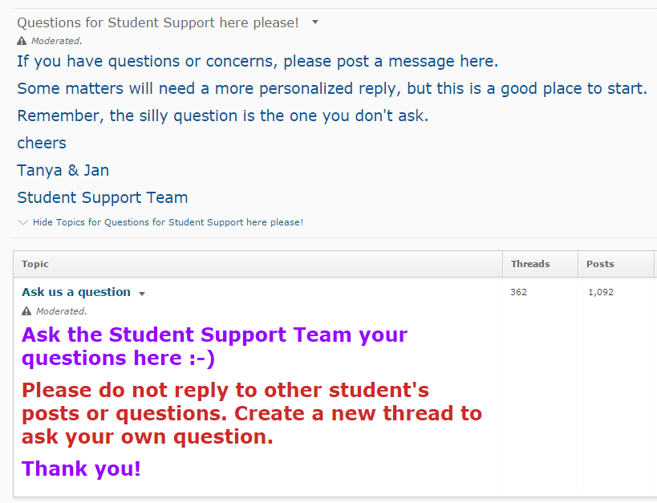
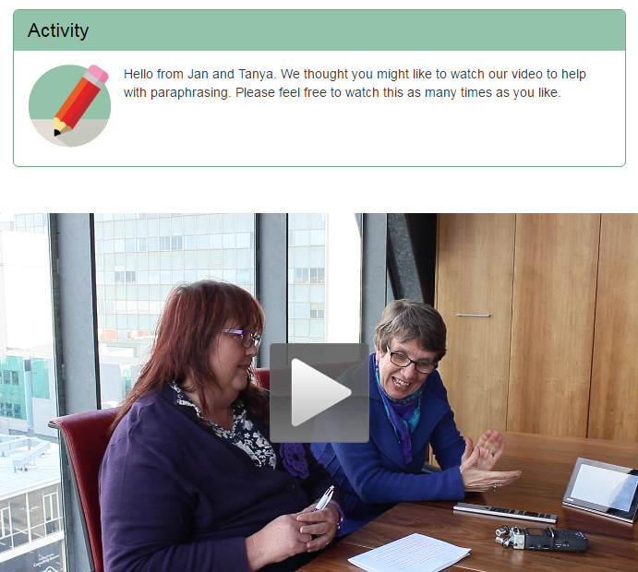
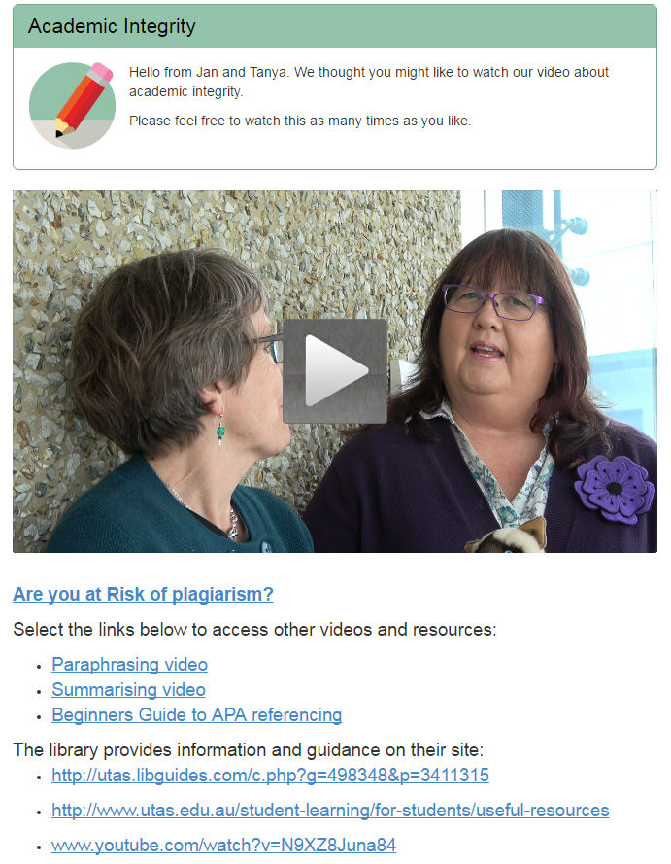
The Common Room

Slide 5
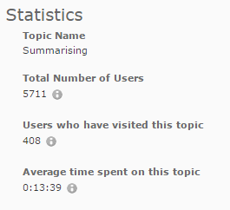
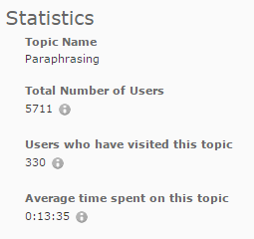
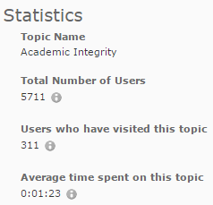
Data about visits to the vignettes- summary of who, how long, how often

Slide 6
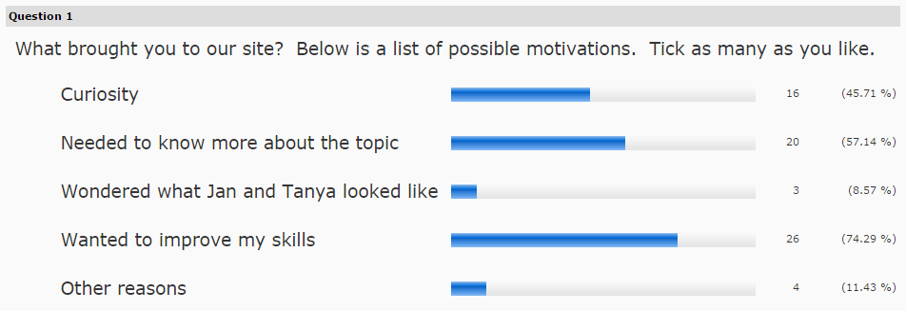
The questions we asked

Slide 7
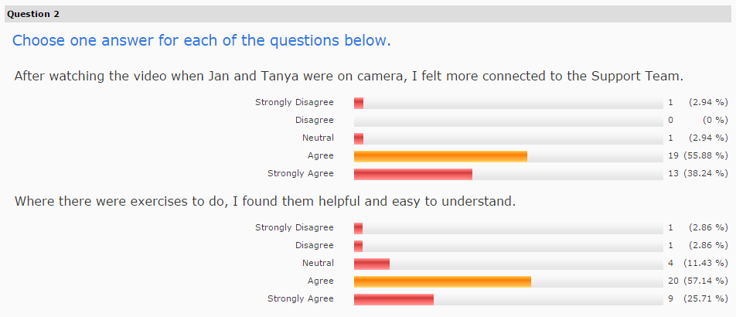
The questions we asked

Slide 8
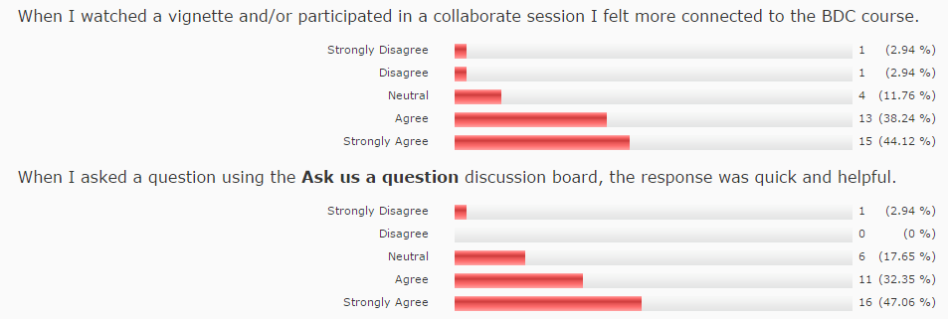
The questions we asked

Slide 9
Wicking Dementia Research & Education Centre
THANK YOU
http://www.utas.edu.au/wicking
Tanya Wadwell and Jan Counsell
Title: Teaching Matters 2016
Wicking Dementia Research and Education Centre Email: DementiaCare.Support@utas.edu.au
©University of Tasmania 2015
Unless otherwise stated, this presentation and all content within it is the property of the University of Tasmania and is protected by copyright and other intellectual property laws.

