Slide 1
ESP322Organisation in Community Sport and Recreation
Teaching Matters
December 2016
Casey Mainsbridge

Slide 2
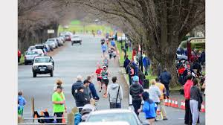
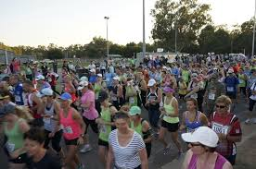
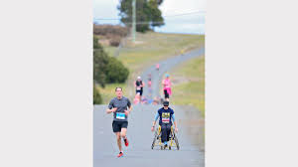
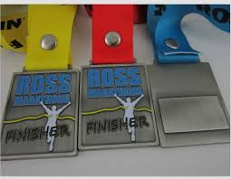
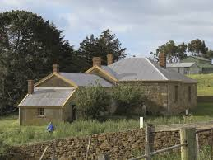
How This Unit Came to be……. From Humble Beginnings

Slide 3
Healthy for Life
The benefits of being physically active are significant for both individuals and the whole community. It is critical, therefore, that a concerted effort is made to increase the physical activity levels and to provide opportunities for all Tasmanians to be physically active as part of their everyday life (Tasmanian Physical Activity Plan, 2011). Health professionals can be involved in organising and managing physical activity in a range of contexts. One such context is the community – sport, physical activity and recreation.
This unit focuses on the development of knowledge and skills for the organisation of sport, physical activity and recreation activities within the community. Students have the opportunity to better understand physical activity in community settings and gain “hands on” experience in planning and implementing community based physical activity experiences (through work-integrated learning).

Slide 4
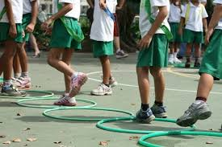
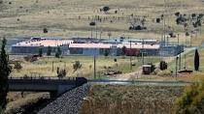
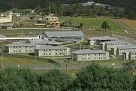

Slide 5
My Role and Unit Assessment
To provide opportunities for the students to collaborate and partner with organisations (value).
To guide the students, provide recommendations and feedback; but to do the ground work for them (empower students).
To encourage responsibility, organisation, and professionalism.
50% of unit assessment is through Assessment Task Two. This incorporates individual student program/initiative plan and evaluation.
Independent external supervisor assessment from partner organisation. This is awarded Pass/Fail.
Additional opportunities for students with schools and associated events; the value of this to their careers.

Slide 6
Outcomes from Work-Integrated Learning
Joshua Mitchell employment with North Melbourne Football Club 2015 – current.
Jesse Holbein casual employment with Launceston-based aged care home currently.
Heather van Der Staay employment with Hawthorn Football Club 2011.
Casual employment with Active Launceston – ongoing.
Continued involvement of students with schools related to carnivals, events, weekly sport, coaching teams, and before/during/after school activities.
Recognition of the importance of engaging with community, and that being a HPE teacher should incorporate more than what happens within the school environment. The value of being resourceful and creating opportunities by identifying gaps or particular needs.
Students gain opportunities to collaborate, form professional relationships, and establish career development skills.

