Slide 1
A win-win approach for students and sustainability
SIPS:
Sustainability Integration
Program for Students
Dr Carmen Primo Perez, CSD
Mr Corey Peterson, CSD
Ms Kim Beasy, CSD
Dr Millie Rooney, CSD
Mr Kamal Singh, CSD

Slide 2




What is SIPS?
Students
Supervisors
Sustainability

Slide 3


How does it work?
Need / Interest
Communication
Project

Slide 4
How does it work?
SIPS
Co-curricular
(PAID)
Curricular:
In-class
Teacher directed
Student directed
INTERNSHIP
Curricular:
Out of class
Independent research
Work placements
(e.g. TSBE Internships)
Honours
PhD
Masters

Slide 5
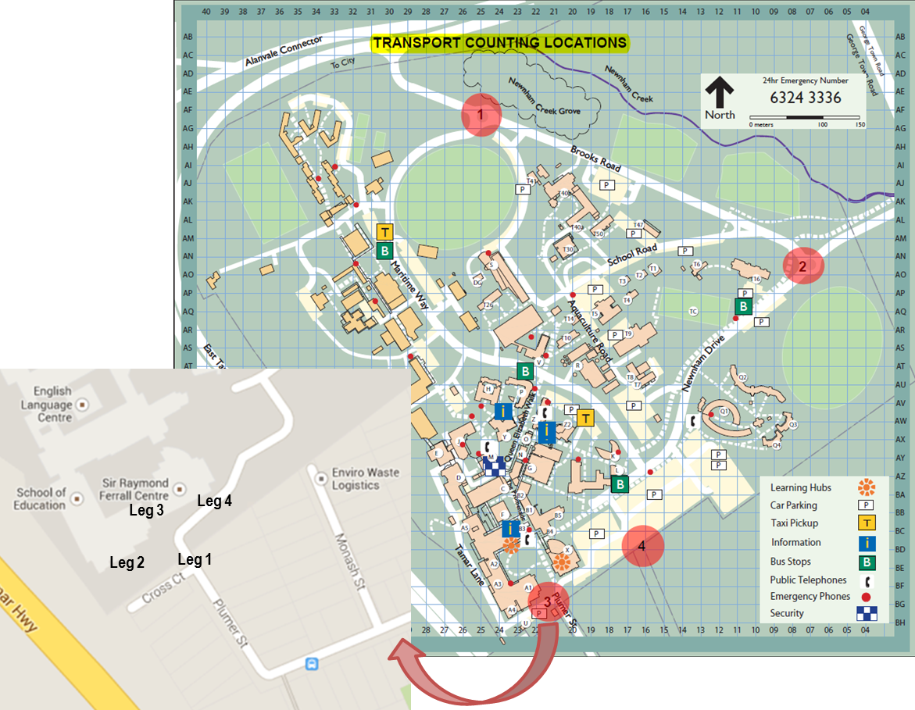
SIPS Transport data collection
KNE111
80 students
Movement counts

Slide 6
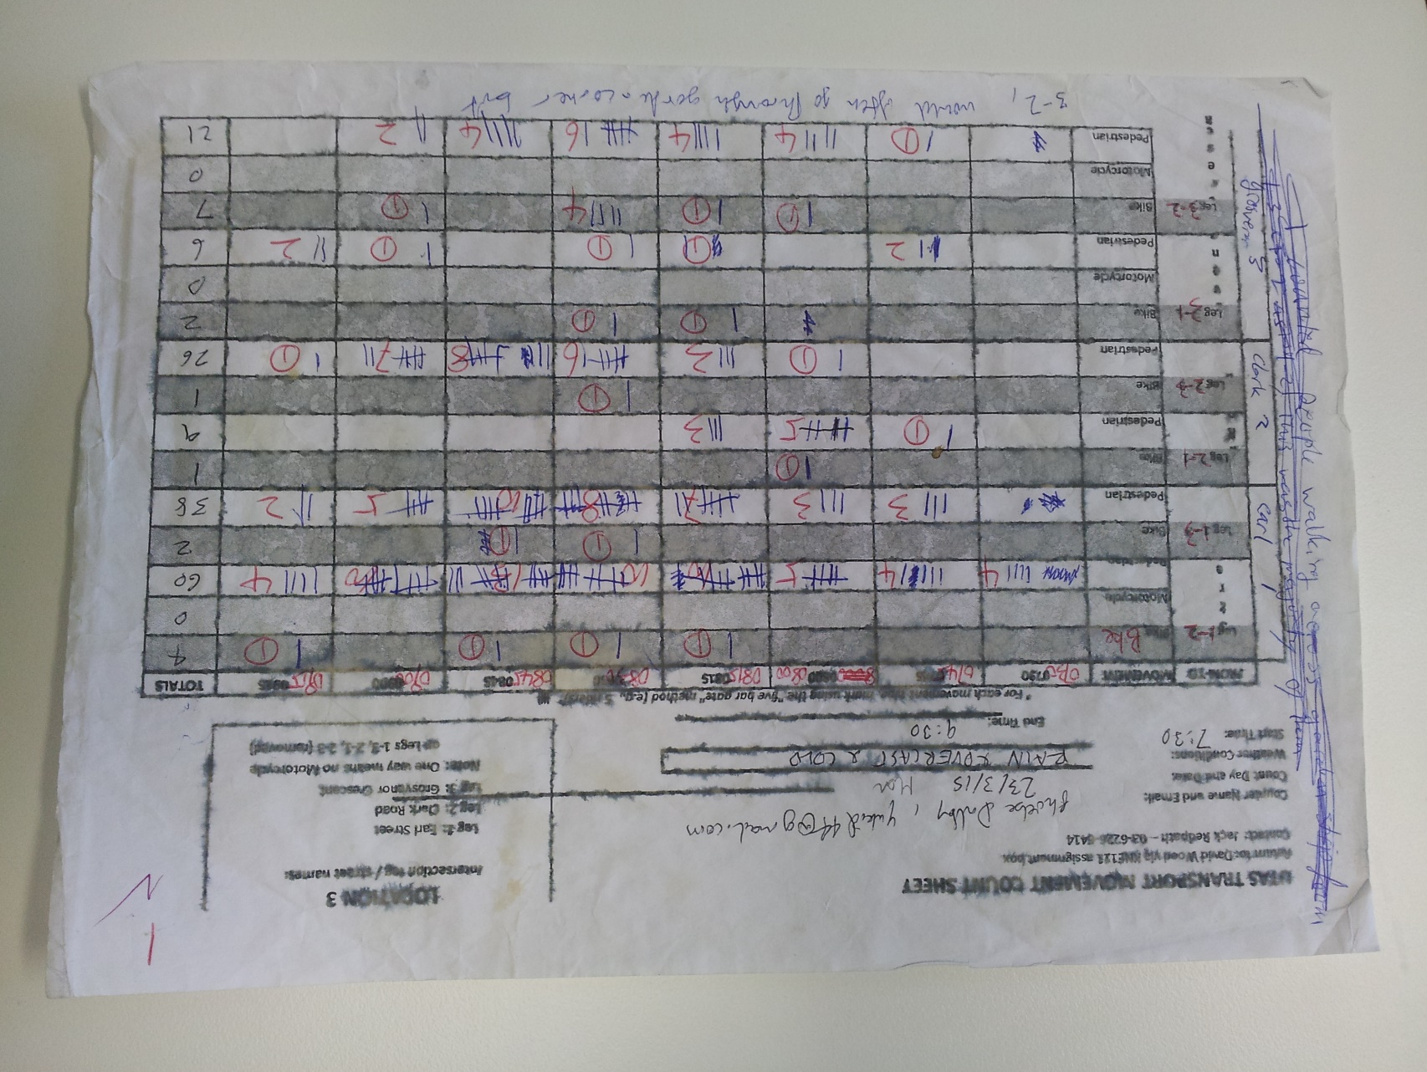
SIPS Transport data collection
Complex
Cumbersome
Prone to errors

Slide 7
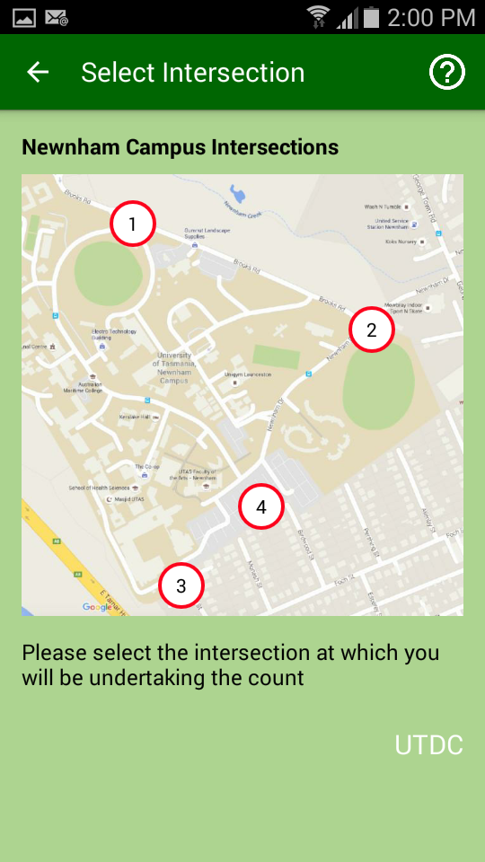
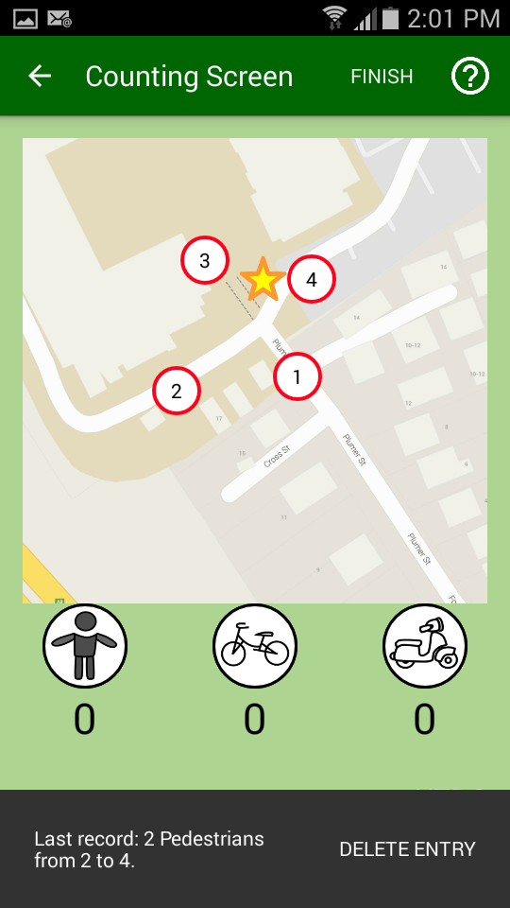
SIPS Mobile app for transport data
KIT301/302
6 students
App development

Slide 8
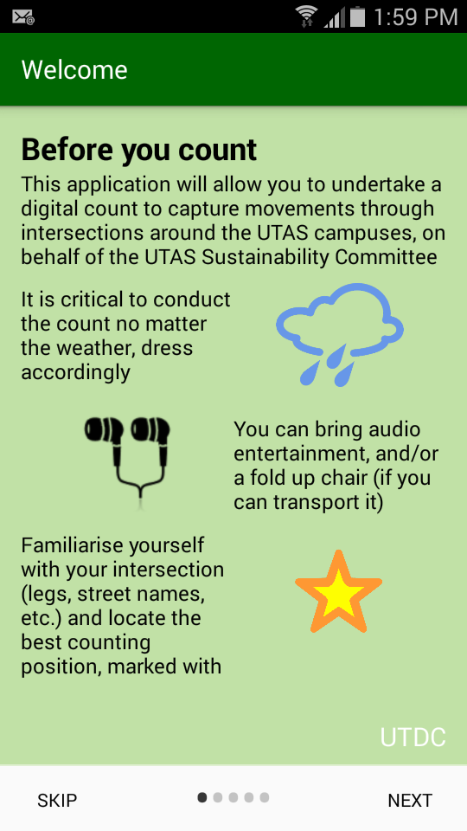
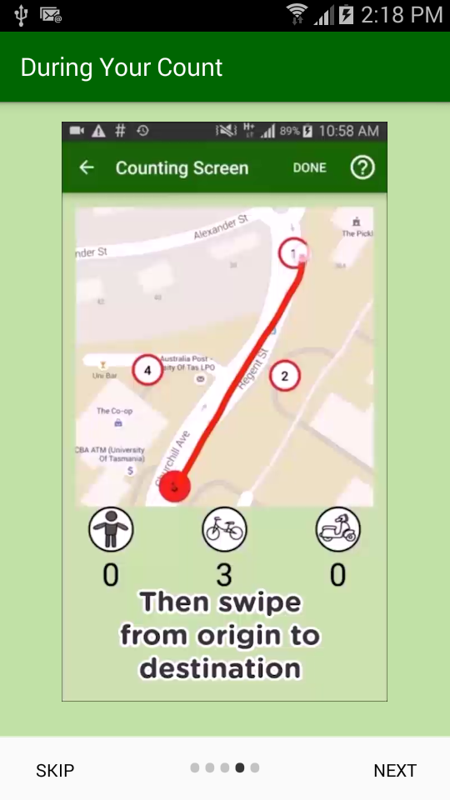
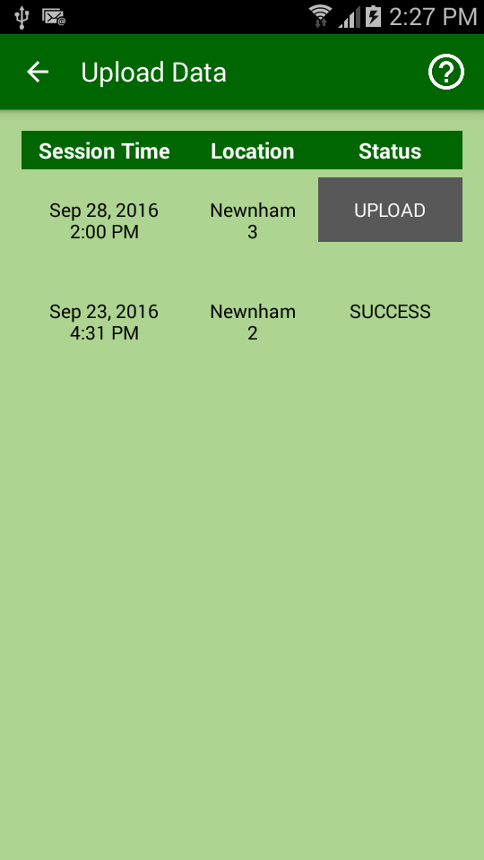
SIPS Mobile app for transport data
All in one
Easier / intuitive
Online data upload

Slide 9

Questions?

Slide 10
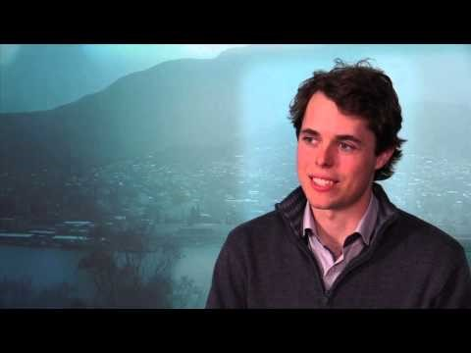
Student experience

