Slide 1
Unifying WIL in Science at the University of Tasmania
Tina Acuna
Andrew Seen
Rebecca Gehling
Nicole Herbert
Susie Haley
Shane Powell
Tina.Acuna@utas.edu.au

Slide 2
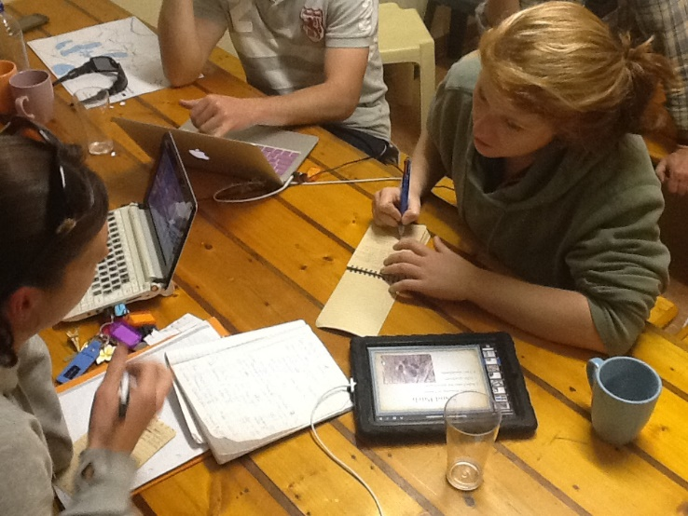
WIL in Science: graduate employability
WIL builds graduate employability (National WIL Strategy, 2015)
Science students have less access to WIL (Edwards et al, 2015)
A national project to develop work-integrated learning in Faculties of Science from the ACDS
 | Placement
Engineering | All
ICT | 3/4
Ag and enviro | 1/4
Science | 1/7

Slide 3
WIL in Science
Intention &
plan
Build & trial
Refine and expand
National leadership network
Ongoing peer-to-peer learning
National consensus
Build capacity: resources and mentoring
Build understanding of WIL
Share standards and course structures
Science graduate and student voice
WIL Guide for Science
Action to foster WIL: lighthouse projects
Industry relationships
Alignment with university

Slide 4
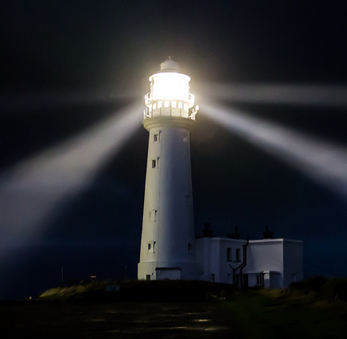
WIL in Science: lighthouse projects
http://www.acds-tlcc.edu.au/centreprojects/work-integrated-learning/
Illuminating the WIL journey for Faculties
Strategy & objectives
WIL activities
People
Systems
Build and trial: Developing alternative approaches to WIL
University of Queensland
Monash University
Intention and plan:
Setting up Faculty WIL programs
University of Tasmania
Western Sydney University
Refine and expand: Extending WIL and building capacity for the future
University of Technology, Sydney
Deakin University
Darren Flinders Flamborough Lighthouse, East Yorkshire, Creative Commons

Slide 5
Project aims
Develop a generic program for on- and off-campus WIL in the faculty
Develop a network of industry contacts for WIL in Science and related disciplines for Tasmania
Create a Faculty Advisory Board for industry engagement

Slide 6
Project aims
Develop a generic program for on- and off-campus WIL in the faculty
Develop a network of industry contacts for WIL in Science and related disciplines for Tasmania
Create a Faculty Advisory Board for industry engagement

Slide 7
A generic program for on- and off-campus WIL in the Faculty
LA#4
Check in with mentor
LA#7
Check in with mentor
Week / Date | Week 1 | Week 2 | Week 3 | Week 4 | Week 5 | Week 6 | Week 7 | Study break | Week 8 | Week 9 | Week 10 | Week 11 | Week 12 | Week 13
Intended Learning Outcomes
Formal Assessment
Learning Activities
ILO 1. Identify and apply the knowledge, skills and attributes required for the professional workplace in a relevant science setting
ILO 2..Communicating and documenting of professional work experience
ILO 3. Working responsibly, ethically and safely as individuals and in collaboration with others
ILO 4. Critically self-reflect on personal strengths and development needs in the workplace
SA#1 Preparation of an EoI and cv demonstrating understanding of the work environment, a risk analysis of work environment and completion of legal agreements
ILO 1, 3
Individual assessment task 20%
SA#2 Document a daily journal that includes: activities, interaction, the experience and employer feedback.
ILO 1, 2, 3
Individual assessment task 40%
SA#3 Write a short reflection on employer feedback; define the knowledge, skills and attributes to succeed in the workplace; complete a proforma on your personal strengths, skills and development needs; revise your EoI. ILO 4
Individual assessment task 40%
LA#1 students completed iPREP and ResumePlus; identified and applied for a work placement/project; complete a risk analysis of the work place; have completed any legal agreements
LA#2. Professional experience (off-campus or on-campus; may be project work for a client in small groups)
LA#3. Journal reflections on professional work

Slide 8
Student feedback What work have you done?

Slide 9
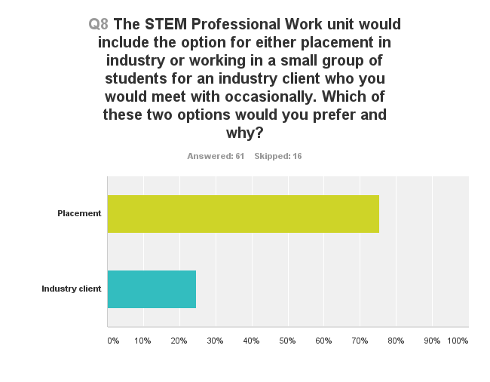
Placement vs. project work in a team for a client
Placement is:
‘More realistic and relevant’
‘Build up [professional] contacts’
‘Promotes communication’
‘Lead to work after graduation’
‘Find out what people do with a degree in my discipline’
I don’t like group work
‘Not for students with a high GPA’
‘Benefits industry, not students’
I like group work
‘Likeminded students, each with a unique perspective to bring to the table’
‘Easier to manage with study’

Slide 10
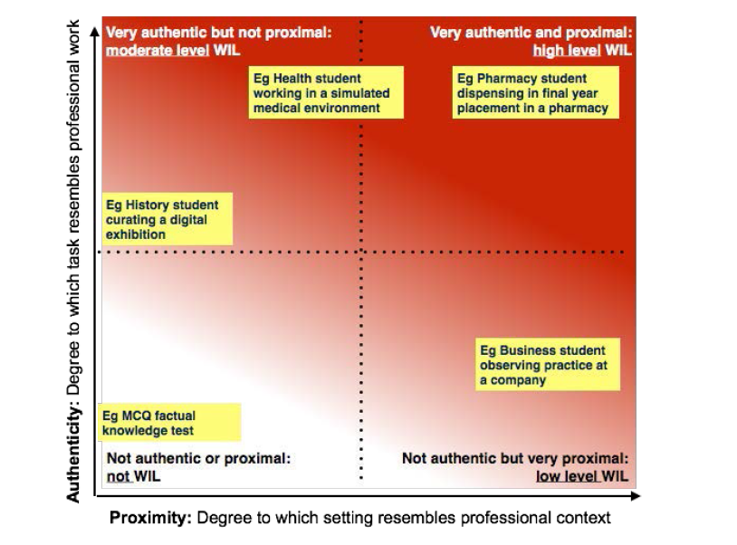
Authenticity and proximity

Slide 11
Focus group discussions with academics who teach in the BSc
‘a good thing. US their cv’s are chocked up with voluntary work; actively seek out experiences’
‘a way through that doesn’t involve…every student into a workplace’
‘a project team isn’t an authentic experience; no opportunity to practice relevant skills, watch someone else’
# | Option | High authenticity, high proximity | High authenticity, low proximity | Low authenticity, low proximity | Low authenticity, high proximity
1 | Placement
2 | Project work for a client
3 | Field trip
4 | In class interaction with an employer
5 | Simulated and PBL
6 | Direct work related skills
7 | Industry research project
‘suggests it’s not WIL…push back on this…WIL assumes task based learning, which isn’t always the case’
N = 21; 10 disciplines

Slide 12
Availability of places
‘Field trip opportunities increasingly restricted due to on-site WHS’
‘Difficult for us to place students locally – if they are finding WIL it’s in the wilds of WA or a leach infested west coast of Tasmania’
‘In the context of geoscience, we would have great difficulty placing someone for 7 – 10 days in Hobart. However for some of our students who take vocational work where they are in a workplace for up to 2.5 months’

Slide 13
Industry
Keen to engage with the university
Graduate employability
Application of skills
Extra-curricula activities
Communication, business acumen
Small companies more agile for accommodating students on placement
Global companies interested in the flexibility offered by group projects
Semesters and timing of work can be out of sync

Slide 14
Conclusions
Positive change towards implementing WIL in the Faculty
Opportunity to aggregate WIL activities in the Faculty
Excellent timing, given the strategic direction of UTAS outlined in our Curriculum Renewal Project
Linkages made with other universities regarding WIL

